Slide 1
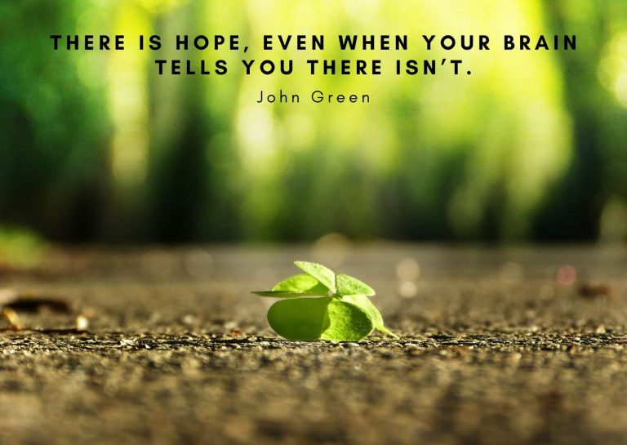
Break the silence : Let’s talk
  Himani Naithani (Integrated B.ed- M.ed second year)

Slide 2
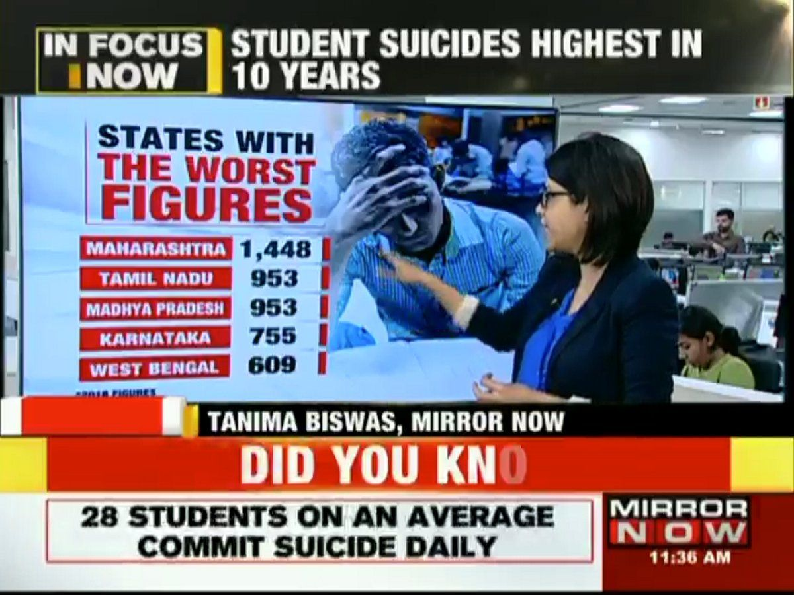
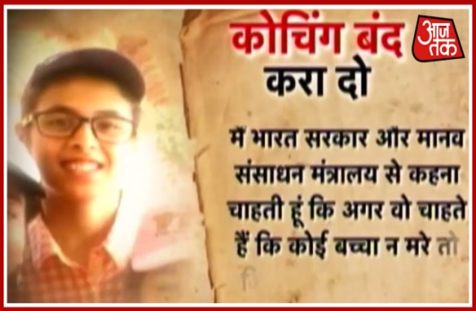

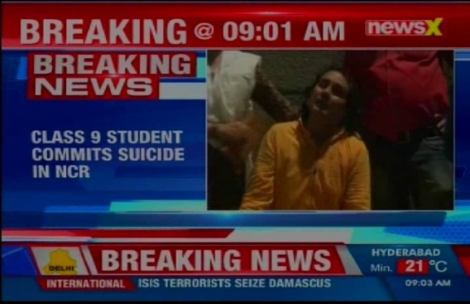

Slide 3
Contents
Mental health
Mental Illness
Making sense of depression
Causes of depression
Symptoms of depression
How can we help a depressed person

Slide 4
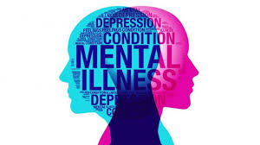
Mental Health
Mental health includes our emotional, psychological, and social well-being. It affects how we think, we feel, and act. It also helps in determining how we handle stress and make choices.
Mental health is an absence of mental illness.

Slide 5
Mental Illness?
Anxiety
disorder
Stress disorder
ADHD/ADD
Depression
Schizophrenia
Eating disorder

Slide 6
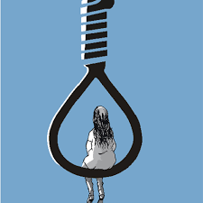
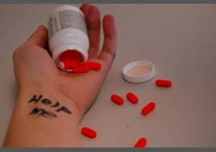
Report of India today
India leads the world in teenage depression ; one in 4 teenagers in India suffers from depression.
Over the last five years, more than 40,000 students committed suicide in India.
One student commits suicide every hour in India.

Slide 7
Making sense of depression
It refers to a profoundly debilitating form of mental illness.
It’s a syndrome that deprives people of their energy, sleep, concentration, joy, confidence, memory, their ability to work and play.
It can even rob them of their will to live.
Over time, depression damages the brain and wreaks havoc on the body.

Slide 8
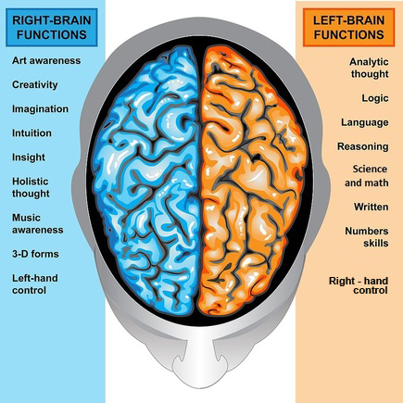
How brain responses in the condition of depression
In our brain when the frontal left hemisphere grows more active than the right hemisphere, our mood shifts in a positive direction and we experience a strong impulse to pursue our goals.
When the left hemisphere shuts down mood takes a sharply negative turn, goal pursuit stops and become focused instead on avoiding harm.

Slide 9
Depression is linked to a chemical imbalance in the brain.
Serotonin is a chemical messenger. it does its job by hopping from one brain cell(neuron) to the next, relaying its signal in an elegant chemical code . Yet when brain cells don’t have enough omega-3 fats, they gave trouble understanding the message of serotonin, and they start to misfire.
This leads to a massive loss of serotonin function throughout the brain, increasing a person’s vulnerability to the sort of out-of-control stress response that triggers the onset of depression.

Slide 10
Causes of depression
Genetic Factors-
Serotonin transport gene affects the function of serotonin.
This gene comes into two versions, dubbed long and short.
It does not mean that if you don’t have certain kind of genes, you will not have depression. Presence of such genes increases the chances of depression.

Slide 11
2. Urbanization
Less contact with nature
By inhaling, S₂O, N₂O and all the other pollutants significantly increases the chances of ADHD, anxiety disorder and so on.
The fumes you are inhaling are affecting the neurotransmitters in the brain and affecting our moods.

Slide 12
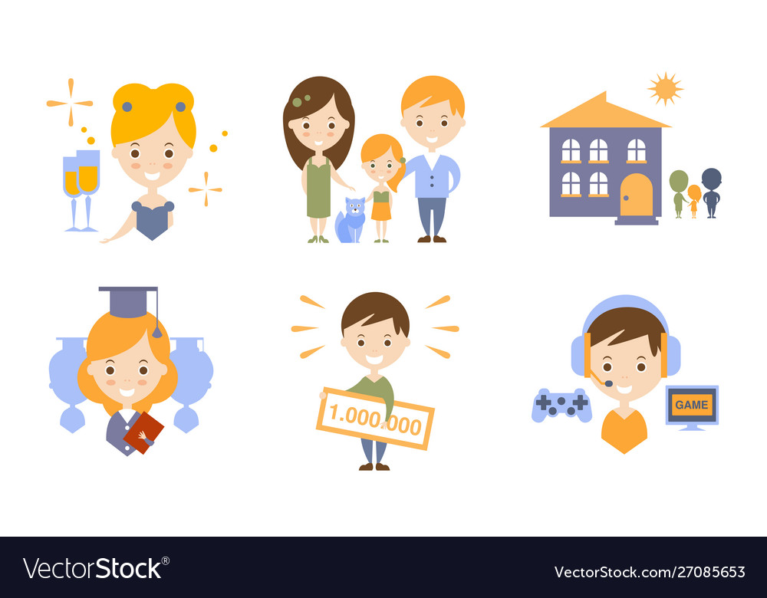
3. Changed lifestyle
Emerging nuclear Family
Food habits
Less physical work
Sleeping pattern
Less social interaction

Slide 13

4. Self expectation and social expectation
“ Being a high achieving student when you have had over 95 percent grade throughout your life, even getting a 90 per cent seems like too much of drop. The entire world is telling you that you can do better, but suddenly you feel that I don't want to do better, I want to try out other things in life,"

Slide 14
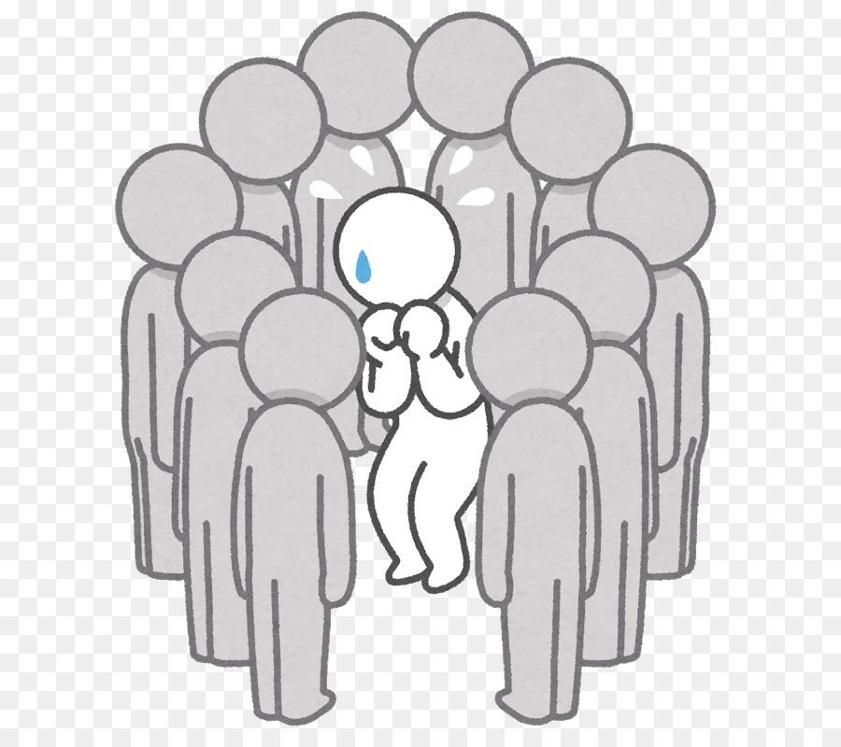
5. Peer Pressure
Everyone wants to fit in with their peers and people they admire. Teenagers are already struggling to define and discover who they are as a person. When peer pressure demands that they act in ways with which they are not comfortable, it can cause teens to suffer from low self-esteem, anxiety, and depression.

Slide 15
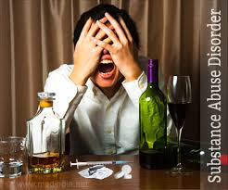
6. Substance abuse-
Drugs and alcohol are chemicals and have a significant effect on the chemistry and cell composition of the brain. Over time, the effects of substance use can change the way the brain operates and regulates emotional and mental functioning, leading to a chemical imbalance that contributes to the development of depression in many teens.

Slide 16
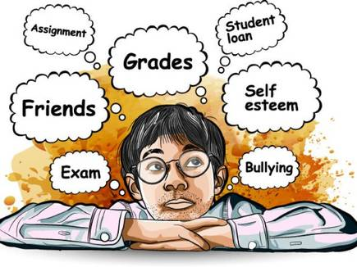
Other causes
Child abuse
Sudden demise of closer one
Suffering from a disease since a long time period
Domestic violence
Bullying
Parental pressure

Slide 17
Symptoms of depression
Depressed mood
Loss of interest or pleasure in all activities
A large increase or decrease in appetite/weight
Insomnia or hypersomnia
Slowing of physical movements, or severe agitation
Intense fatigue
Excessive feelings of guilt or worthless
Difficulty in concentrating or making decision
Frequent thoughts of death/suicide.

Slide 18

How can we help a depressed teen
1. Encourage Social Interaction
Make face time a priority
Combat social isolation
Get your teen involved
Promote volunteerism

Slide 19
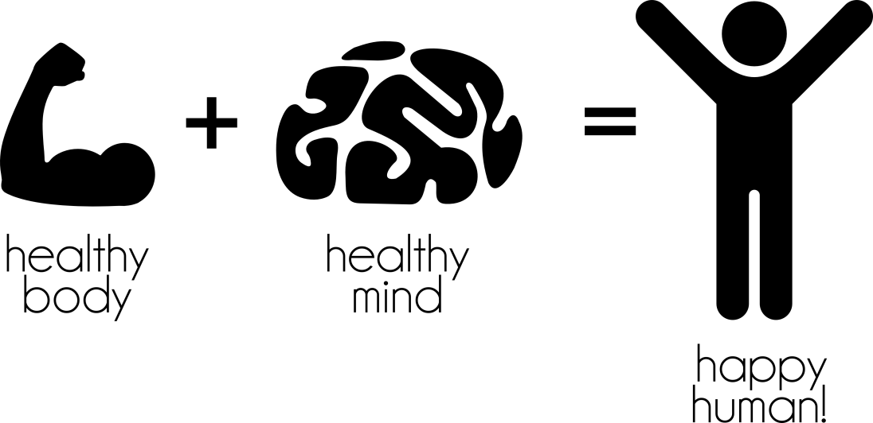
2. Make health priority
Proper nutrition
Physical exercise
Proper sleep
Sunlight exposure

Slide 20
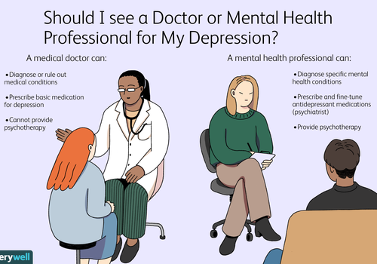
3. Know when to seek professional help
Don’t hesitate to consult to the doctor/counsellor.
Involve your child in treatment choice.
Explore your options of treatment.

Slide 21
4. Support your teen through depression
Be understanding
Stay involved in treatment
Be patient
Listen her/him patiently
Be open with the family
Remember the siblings
Make her/him understand the meaning of failure

Slide 22
5. THE ADOLESCENT DEPRESSION AWARENESS PROGRAM
It is developed by two psychiatrists and one psychiatric nurse.
It is a depression literacy program delivered to teen age students by teachers.
This mode of delivery represents an effective and sustainable way to increase awareness of mental health, reduce stigma , improve early detection and facilitate help-seeking behavior among adolescents.

Slide 23
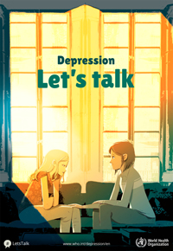
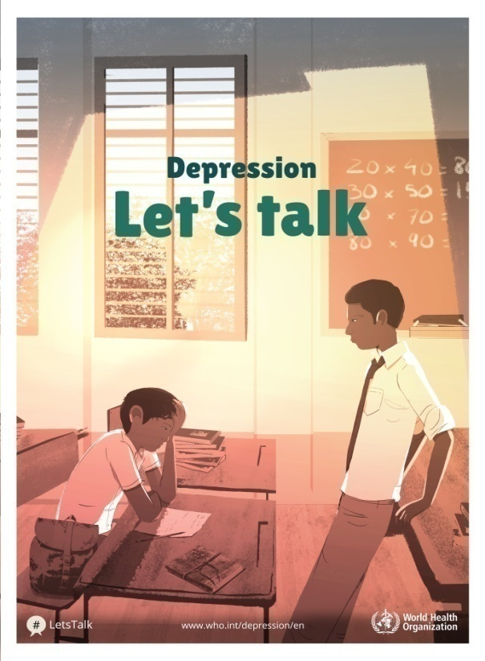

Let’s talk
A conversation can save someone’s life

Slide 24
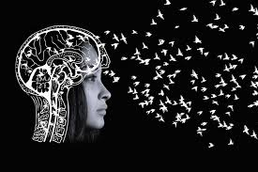

Thank You

