Slide 1
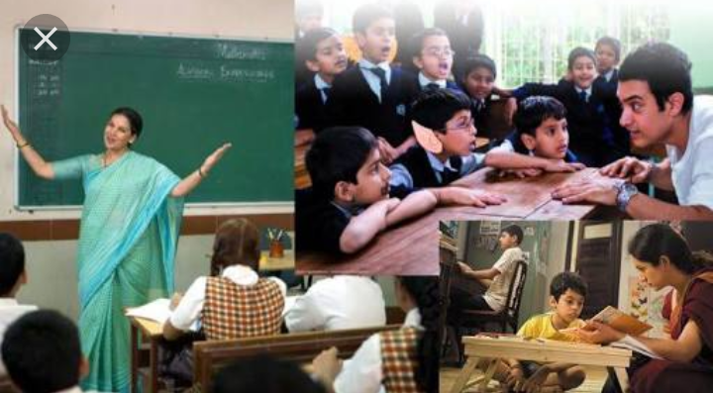
EDUCATION
THE CHANGE IT NEEDS

Slide 2
Education:-
Education is the process of learning or getting of knowledge,skills, values,and habbits of essential needs of life.

Slide 3
Indian vs foreign education system:-
We used to compare our India with other countries in other facilities and laws then why we are not comparing our education system with other countries..
Wheather Dhiru bhai or Dr.A.P.J Abdul kalam are products of our Indian education system?

Slide 4

WHY IT NEEDS A CHANGE?
It is because we the educated class of India aren't knowing the difference between being educated and acting as educated...

Slide 5
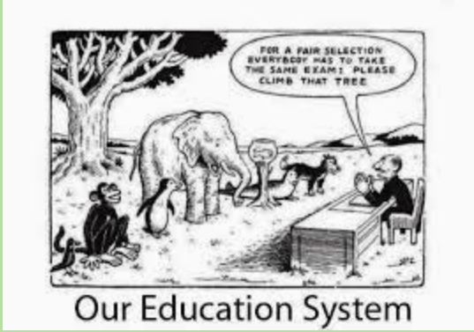
Fair or Unfair?

Slide 6
Actual process :-
Success
Application
Education
Passion
Learning

Slide 7

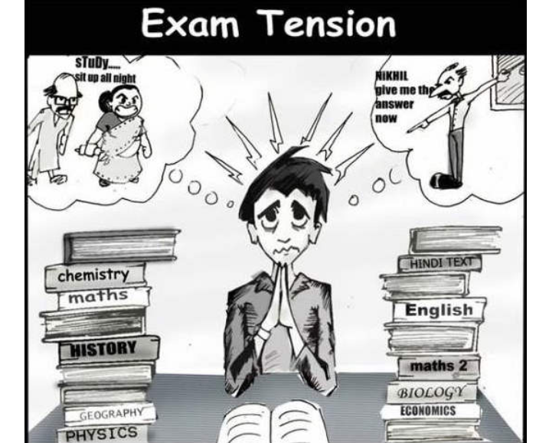
WHAT'S REALITY:-
No process followed..we just go with the flow
Teacher centered instruction method and rote learning become norm.
Success measures in terms of grades.
Additional pressure
Contradiction in our content and process.

Slide 8
What should be done
We should start learning.Learning starts from
Home
Self
Environment
Continuous process

Slide 9
What we need our children to learn:
Real world skills-life skills
Soft skills
The interest identification
Processing thought and independent thought
Physical education
Sex education- in right sense

Slide 10
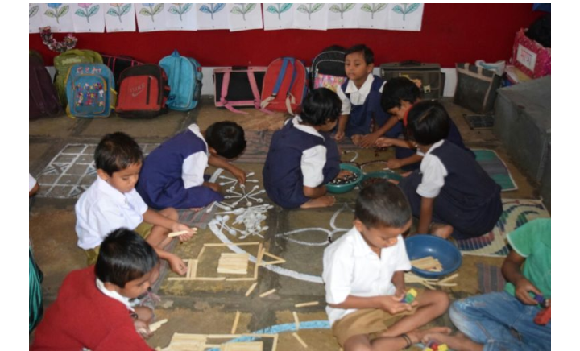
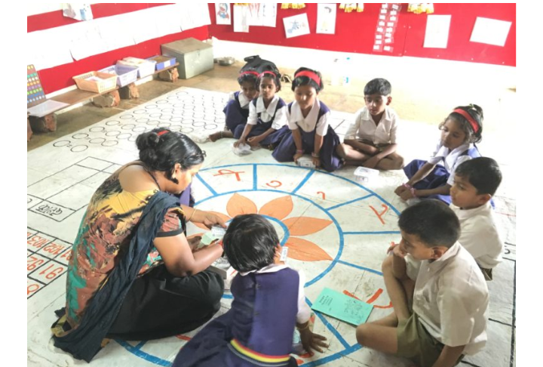
How can we bring change:-
Channelize all the energy of the children
Study and play
Nurture the inquisitive nature of the children
Give them a taste of success as well as teach them how to deal with failure.

Slide 11

What we can achieve
The best in every field
Successful people who will make successful people
Our nation in world stage
A happy and satisfied Education system
What will it make finally
A BETTER NATION

Slide 12

Thank
You

