Slide 1
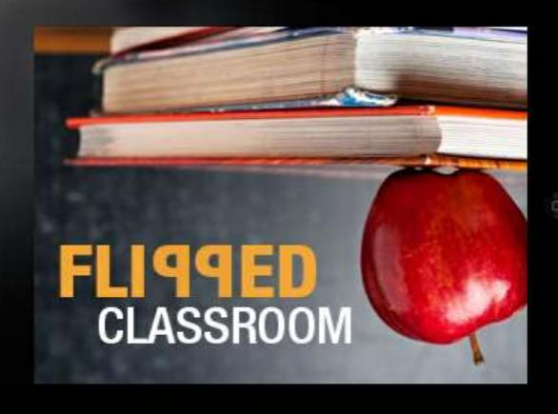
Flipped classroom:-
A step towards constructivism
Presented By- RASESWARI NANDA
IntBEd-Med(I year)
RIE,NCERT,Bhopal

Slide 2
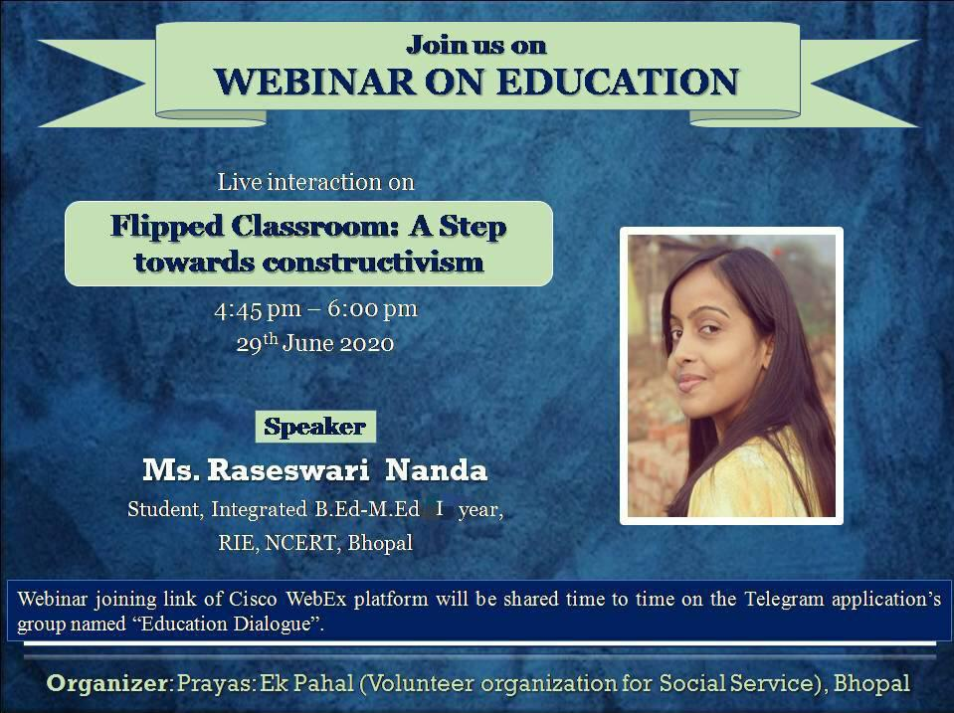

Slide 3
Where it started…..??
Students learning at different paces(slow,medium,Fast).
Students being absent (sick,sports) and missing the lessons.
Students not completing homework fully or correctly at home because they “forgot” how to do it or simply copying from a friend.
Teacher spending most of the class time in lecturing and not giving student a lot of time to participate on their own without support.

Slide 4
What is a flipped classroom???
Flipped classroom is a teaching strategy that reverses the traditional learning environment by delivering instructional contents outside the classroom.
It moves activities like assignments,homework,projects inside the class
In the flipped model, students get their lectures at home at their convenience and do the assignments in their classroom.
The lectures are not time-bound; students can access and review the same lecture numerous times.
Classrooms are becoming more active, the teacher is turning into a coach, and he converts the classroom into a studio where students collate, collaborate and put into practice what they learn online.

Slide 5
A classroom where students are absent due to illness Or extra-curricular activities don’t get let behind
In a flipped model, students get desired lectures in the form of pre-recorded videos or access those that they understand better, over the internet.
Flipped classrooms have transformed the one-to-many model of passive teaching into a one-to-one active coaching.
A way to increase interaction between teacher and student.
An environment where students take responsibility of their own learning.
A blend of direct insturction with consturctivist learning.

Slide 6

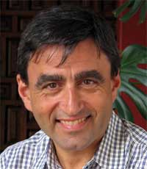
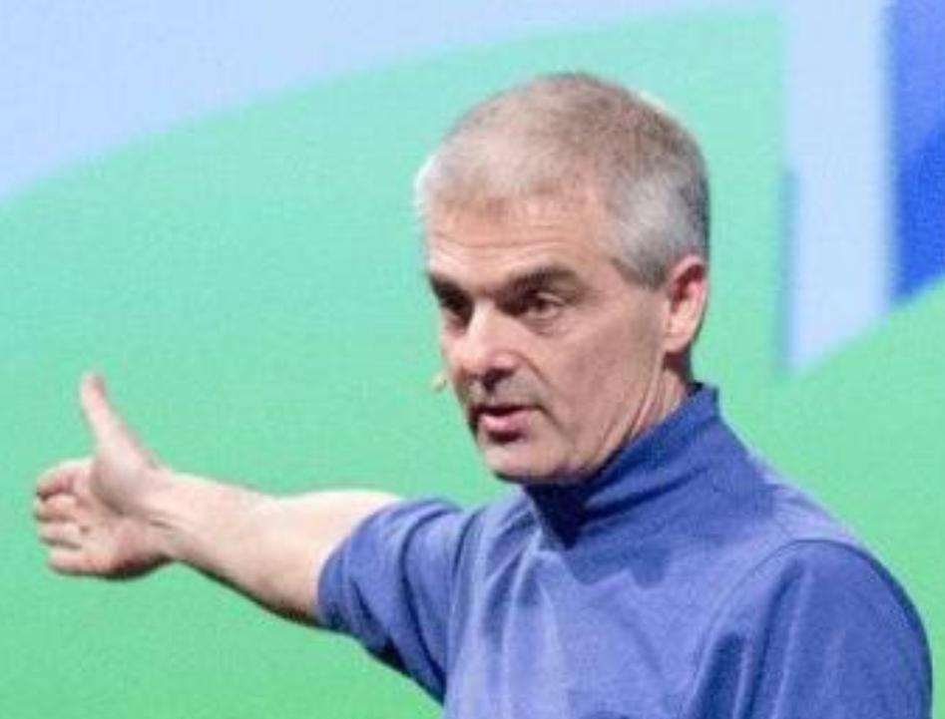
History of Flipped classroom
In 1993, Alison King published "From Sage on the Stage to Guide on the Side," in which she focuses on the importance of the use of class time for the construction of meaning rather than information transmission.
Harvard professor Eric Mazur played a significant role in the development of concepts influencing flipped teaching through the development of an instructional strategy he called ￼peer insturction.
John Bergamnan is also one of the pioneer of flipped learning.

Slide 7
Flipped learning is a new concept in the education dictionary in india:-
With the launch of Operation Digital Blackboard on February 20, 2019, by HRD Minister Prakash Javadekar, a new word entered in the education dictionary -- 'flipped learning'. The concept is very innovative and futuristic. Flipped learning is a concept wherein students focus on shorter duration video lectures and other content before entering the traditional classroom arena. When they enter the classrooms with the prior knowledge of the concept, the learning becomes more of an interaction and collaborative process

Slide 8
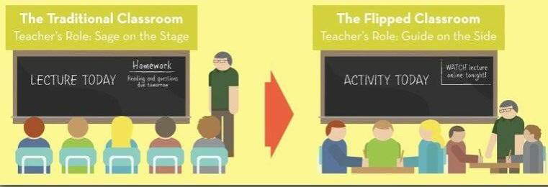
Why flipped classroom???

Slide 9
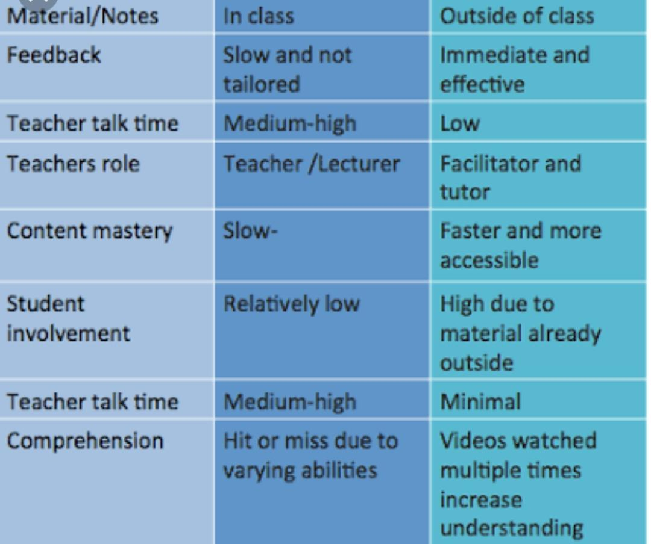
Traditional classrooom
Flipped classroom

Slide 10
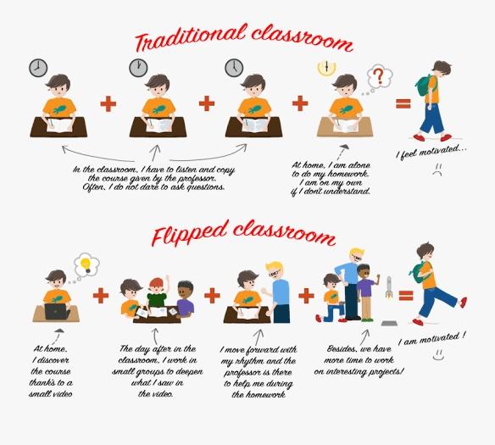

Slide 11
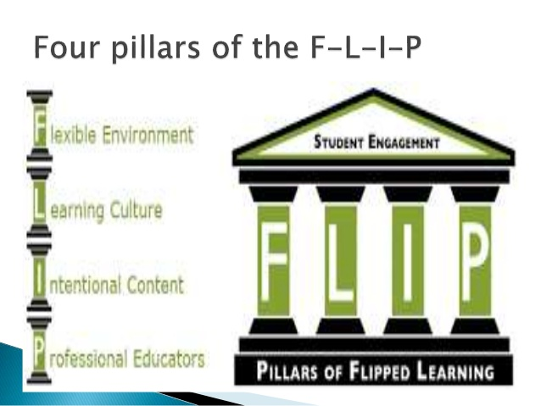

Slide 12
Flexible environment-In flipped classroom the teacher need to create flexible learning environment by providing opportunities for student to choose when and where they want to learn.
Learning culture-In flipped model ,class time is shiftimg to discuss more in-depth about each topic.It changes the traditional learning culture to learner centred class.As a result students are actively involved in knowledge construction.
Intentional content-In flipped model teachers determine what they need to teach and what materials students should handle on their own.Here teacher use intentional content to adopt learner-centred and activity oriented class.
Professional Educator-The flipped model need educators who can observe, provide timely feedback,Continuously assess work and help student to do mastery over content.This is something a professional educator can do.

Slide 13
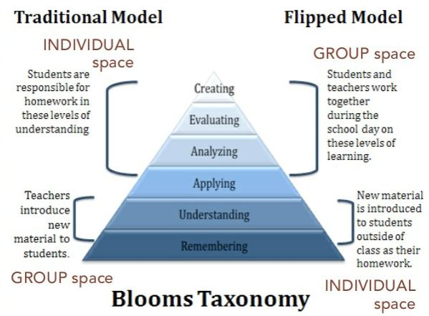
Just a comparison….

Slide 14
Who it is good for??
Struggling learners
Gifted learners
High achieving learners
Students who love to learners

Slide 15
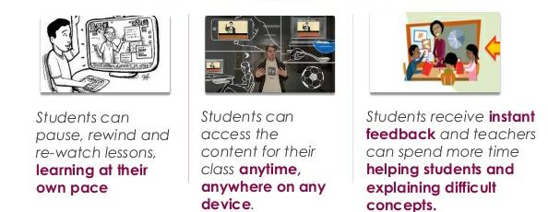
How students get benefitted from flipped classroom???

Slide 16
Student benefit and goals…..
Don’t have to worry about.
Can focus on..
Being an active,responsible learner;
Working and collaborating with classmates to deepen understanding;
Working with concepts they need more support in learning;
Manage their time to meet given learning objectives;
Being absent and missing content
Lessons being taught too fast to comprehened;
Getting stuck on homework problem with no support;
Forgetting old materials and having no way to re-assess it.

Slide 17
Advantages of flipped classroom:-
It can promote student centred learning.
Lessons and content are more acessible for students.
It gives more time to explore the content.
It promotes cooperative learning.
It encourage students to come to class prepared.
It promote more collaboration time for peer learning.
Students can control their learning.
More efficient for teachers.

Slide 18
Disadvantages of flipped classroom:-
Students may forced to spent time in front of the screen.
Teachers may have extra work.
It depends upon preparation and trust.
More preparation time for using technology etc.
More need for monitoring.

Slide 19
Final thought on flip:-
“The flip”is only one tool in our textbook but it is a powerful one.
Flipping can work in any subject area and on any grade level.
Using this ideology has ultimate goal of increasing student understanding and ownership of the content.
The flipped classroom is about increasing 1:1 time with the students.

Slide 20
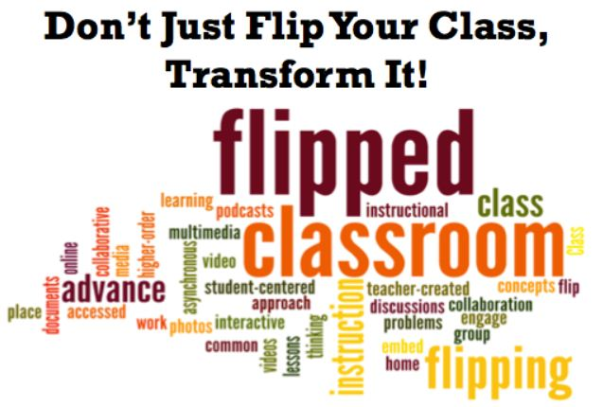

Slide 21
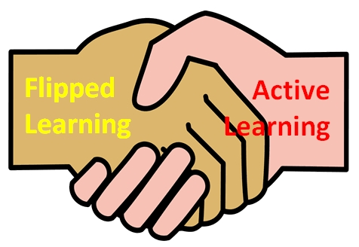
Thank you all for your kind attention…

