Slide 1

INVISIBLE BUT EDUCABLE
MANISHA RATH
INTEGRATED B.ED M.ED
REGIONAL INSTITUTE OF EDUCATION, BHOPAL

Slide 2
Learning Disabilities are often difficult to recognise because they are HIDDEN DISABLITY and not easily diagnosed and the person looks perfectly normal.

Slide 3

LEARNING DISABILITIES

Slide 4
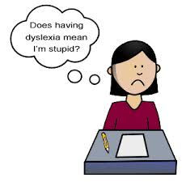

It is not stupidity.
It is not laziness.
It is not willfulness.
It is not lack of interest.
It is not anything to be ashamed of.
It is not the end of world.
It is not necessarily permanently disabling.

Slide 5
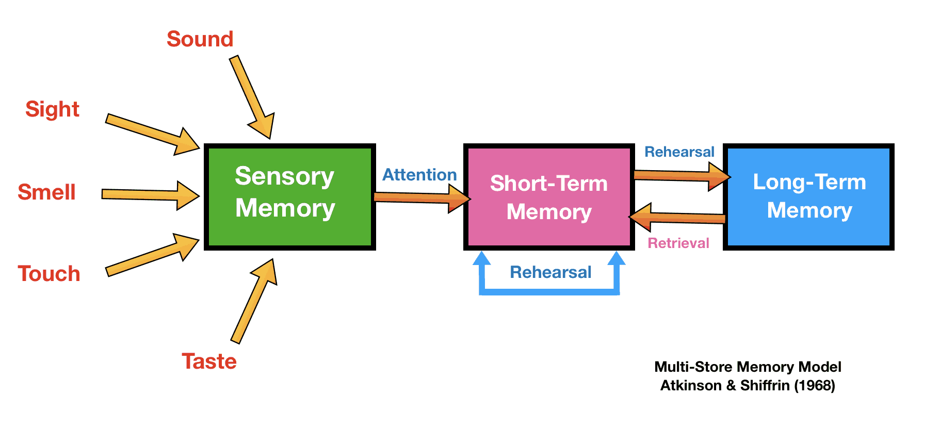
Learning The Psychological Process

Slide 6
A BREAKDOWN IN THE LEARNING PROCESS
LEARNING DISABILITY

Slide 7
What is Learning Disability?
LD is a umbrella term for a wide varieties of learning problems.
Neurologically based processing problems.
Affects one or more cognitive processes related to learning like reading, writing, mathematics, language, comprehension.
Skills like organization, time planning ,attention etc are affected.
People are of average or above average intelligence.

Slide 8
Specific learning disabilities in children:
Specific learning disabilities pertains to difficulty in specific areas of learning
Dyslexia - A learning disorder characterised by difficulty reading.
Dysgraphia - Inability to write coherently.
Dyscalculia - Difficulty in learning or comprehending arithmetic.

Slide 9
CAUSES
Genetic factors:
Some evidence LD often runs in family.
Pre-natal:
If the mother:
Uses drugs
Consumes alcohol
Suffers from malnutrition, rubella, severe sickness.
Peri-natal:
Anoxia
Injury to child’s brain
Any other method of delivery causing injury to brain cells
Post-natal:
Biological or Biochemical Causes
Environmental causes

Slide 10
BRAIN ANATOMY
Dyslexia results from a neurological difference i.e. brain difference.
Deficit in parts of left hemisphere of the brain involved in reading.
Significant strengths in areas controlled by the right side of the brains such as artistic , athletic and mechanical gifts,3D visualization ability , musical talent.
Impairment of cerebellum

Slide 11
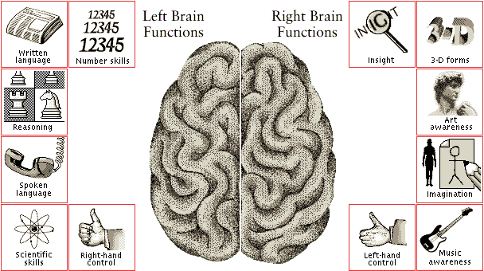

Slide 12
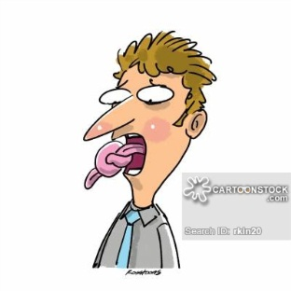
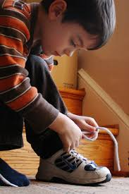
IDENTIFICATION
PRE SCHOOL AND KINDERGARTEN WARNING SIGNS
Delayed speech
Mixing of sounds in multisyllabic words (E.g. : Aminal for animal etc).
Early stammering.
Can’t master in tying shoes.
Immature speech. They may still be saying “wed and gween” instead of ‘’red and green’’.

Slide 13
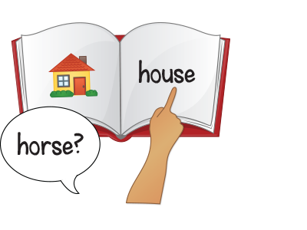
DYSLEXIA - Problem in reading
Can read a word on one page but won’t recognize it in the next page.
Slow , laboured , inaccurate reading .They may say a word that has the same letters but in a different sequence such as who-how, lots-lost, saw-was or girl-grill.
b-d , b-p , d-p , n-u , m-w confusion.

Slide 14
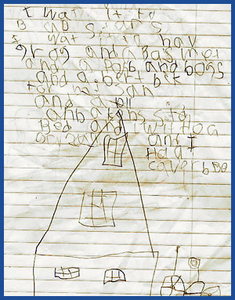
DYSGRAPHIA - Problem in writing
Unusual pencil grip.
Writing is slow and laboured.
Difficulty getting letters to sit on the horizontal line.
Unusual spatial organization of the page. Words may be widely spaced or tightly pushed together. Margins are often ignored.
Avoid writing whenever possible.

Slide 15
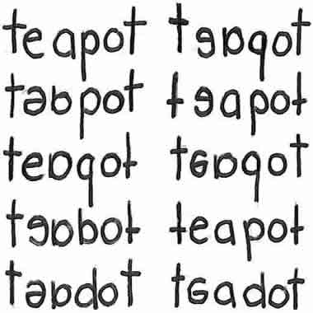

Slide 16
SPELLING
Their spelling is worse than reading. They face difficulty in vowel sound and often leave them out.
Continually misspells high frequency sight words such as they , what ,where ,does despite of extensive practice.
Misspells even when copying something from the board or from a book .
DIRECTIONALITY
Left right confusion.
Up down confusion.
North South East West confusion.
Difficulty in reading and understanding maps.

Slide 17
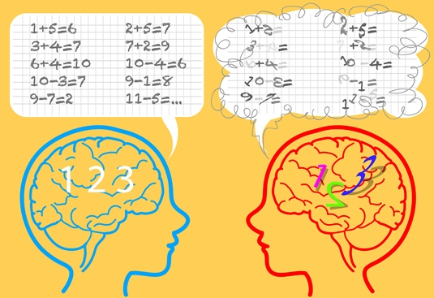
PROBLEM IN MATHEMATICS -DYSCALCULIA
But they face difficulties in :-
Memorizing addition and subtraction facts.
Memorizing multiplication tables.
Remembering the sequence of steps in long division.

Slide 18
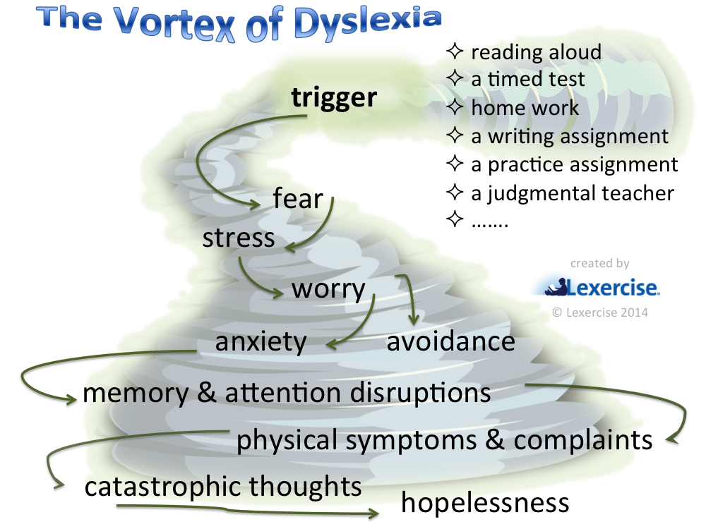
PSYCOLOGICAL EFFECT ON DYSLEXIC CHILD

Slide 19


Slide 20
Teaching Strategies
Task analysis
Structured lesson presentations
Organised equipment and materials
Peer teaching
Cooperative learning
Content mastery classes
Joyful learning
MULTISENSORY METHODS IN
Reading
Writing
Mathematics

Slide 21
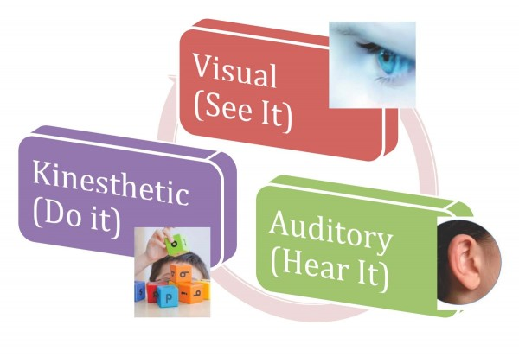

Slide 22
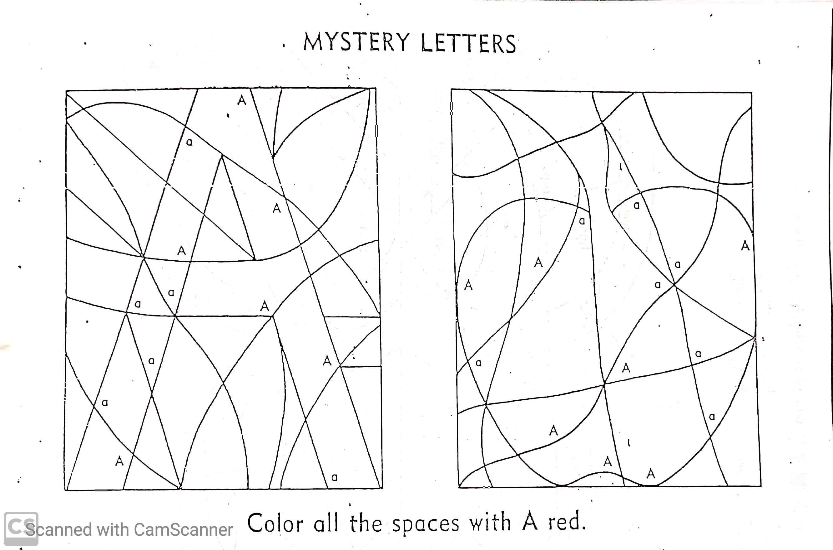

Slide 23
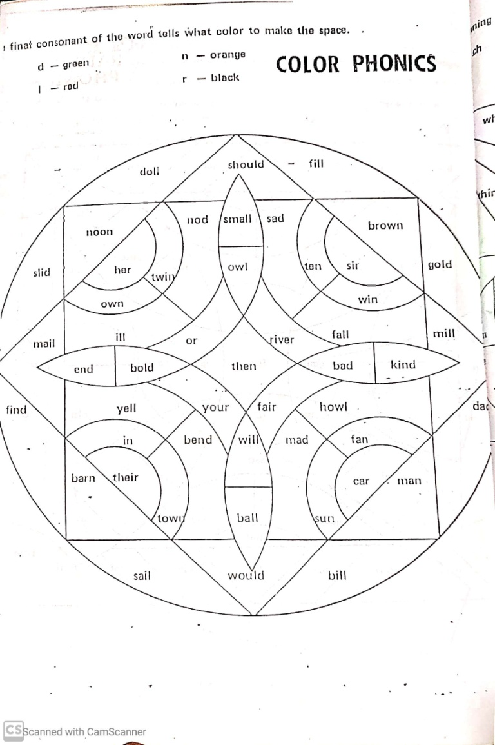

Slide 24
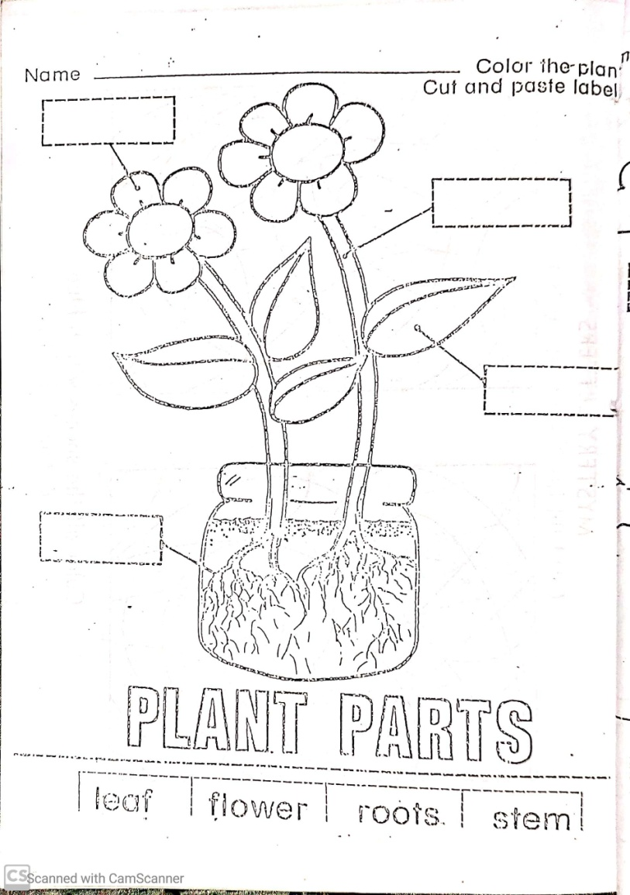

Slide 25
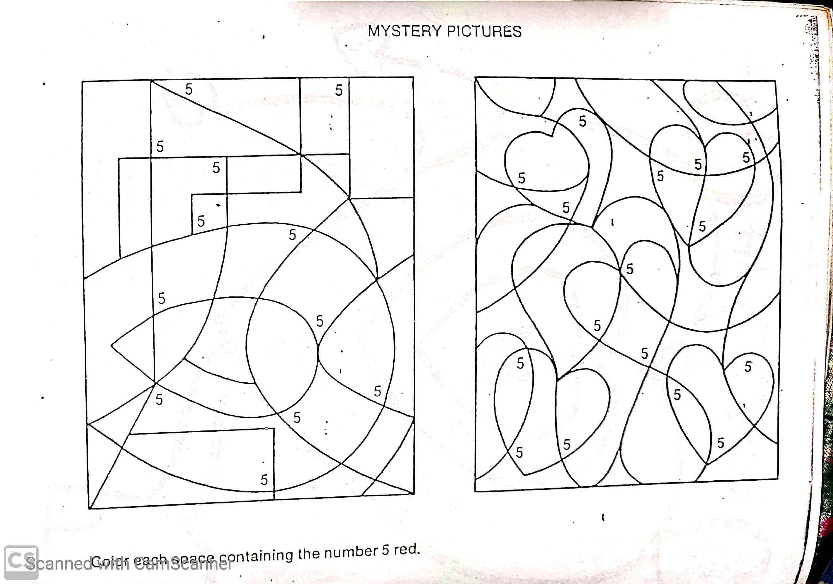

Slide 26
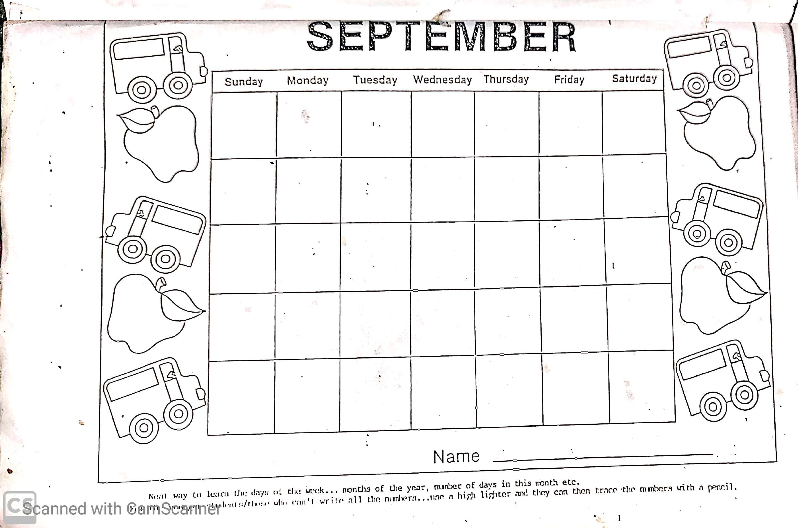

Slide 27
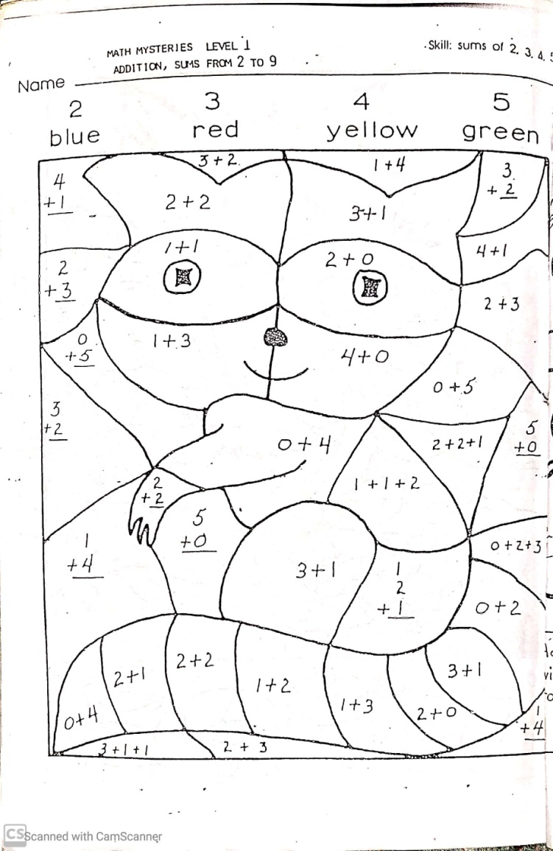

Slide 28


STRATEGIES TO HANDLE DYSLEXIC INDIVIDUAL
Help the child be aware of their problem. By consulting neurologists or psychologists.
Recognize the child’s strength and weakness and to be positive force in their intellectual at growth.
Respect and challenge the child’s natural intelligence.
Play spelling games with the child & encourage them to write.
To give emotional support and motivation which will help them to build a strong self image.
Provide a quite area or activities like reading and answering comprehension.
Use book on tape.
Use of multisensory teaching methods.
Have the child to sit in an erect posture and read aloud, this will slowly help in successful conversion of visual symbols into sound.
Stay involved in child’s education and help them cope with strategies as they advance in school.
Use of computer software where they can type .

Slide 29

Challenges…
Sir Alan Sugar is a very successful businessman.
Some people say that he was good at solving problems and coming up with new ideas because he is dyslexic.

Slide 30
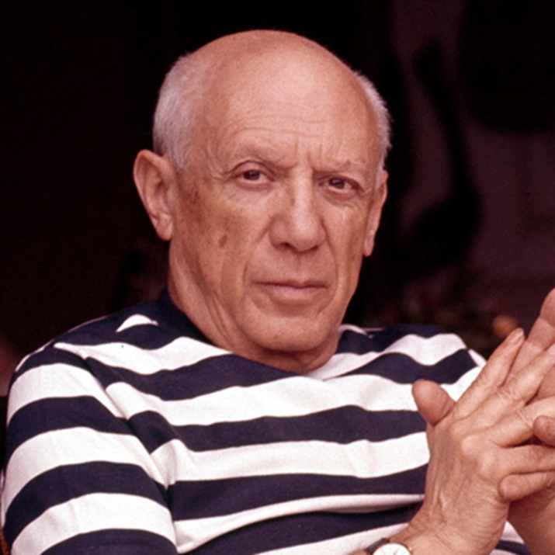
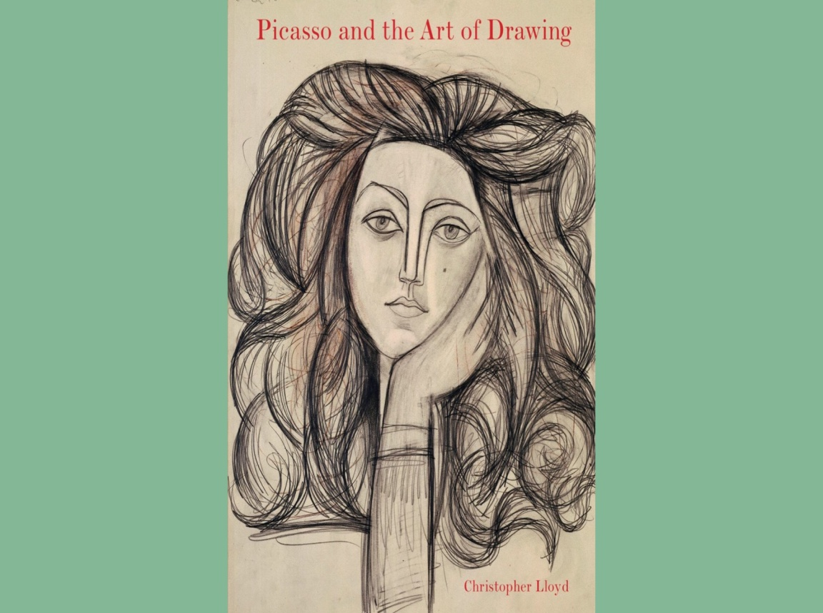
Artistic…
Pablo Picasso is a world famous artist.
People say that he was such a brilliant artist because he was dyslexic.

Slide 31
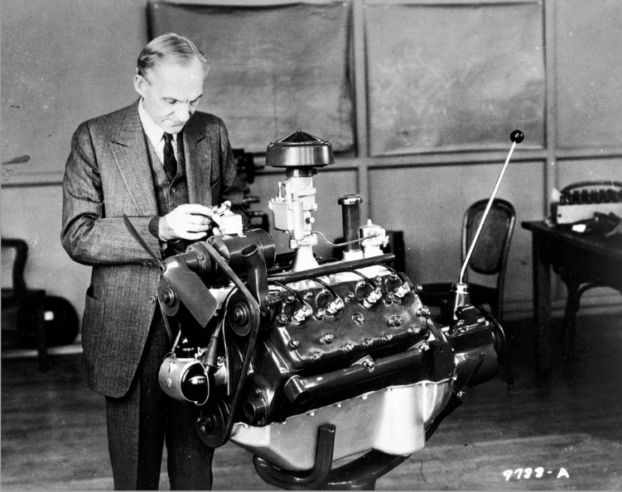

Inventive…
Henry Ford designed the first motor car.
Some people say that he was so inventive because he had dyslexia.

Slide 32
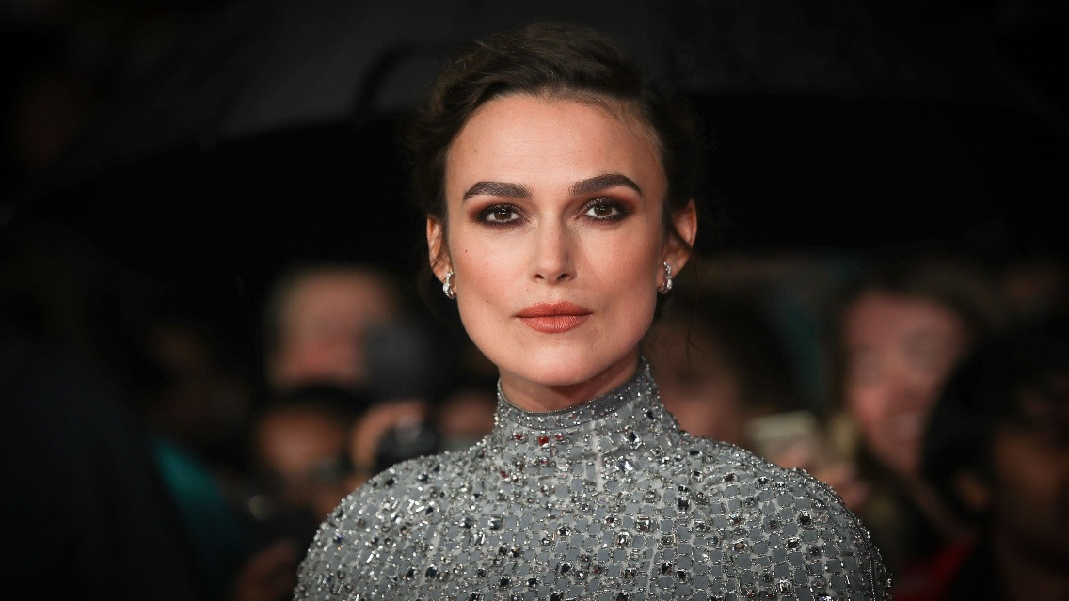
Creative…
Keira Knightley is a world famous actress.
Some people say that she is so creative because she has dyslexia…

Slide 33
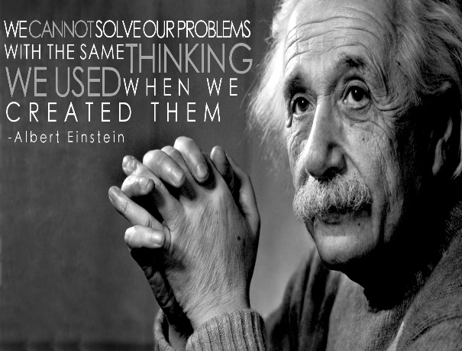
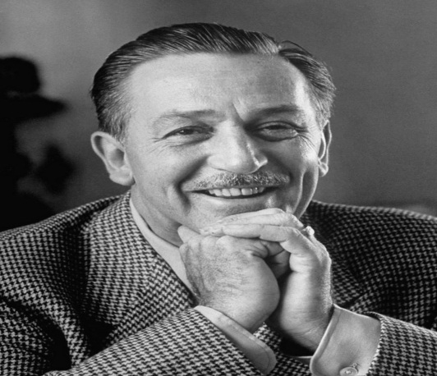
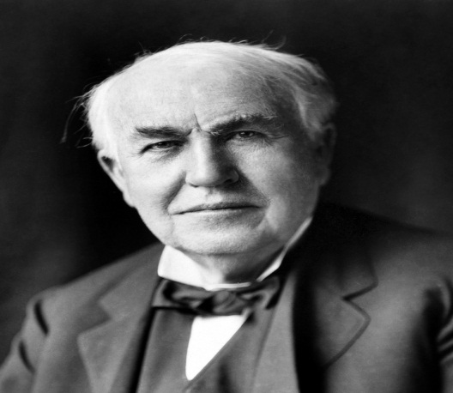
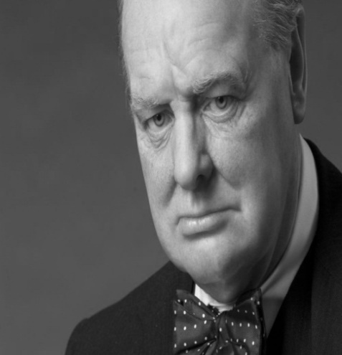


Albert Einstein
Walt Disney
Thomas Edison
OTHER FAMOUS DYSLEXIC PERSONS
Sir Winston
Churchill
Abhishek Bachchan
Tom Cruise

Slide 34
CONCLUSION
Learning disability is prevalent in society though not well recognized or understood.
Having a learning disability does not need to be a disadvantage, it just a different learning style.
Why not we approach learning disability from their advantages instead of their disadvantages. For instance, LD has a nice collections of strength.
Tell me and I forget , teach me and I remember , involve me and I learn.
- BENJAMIN FRANKLIN

Slide 35
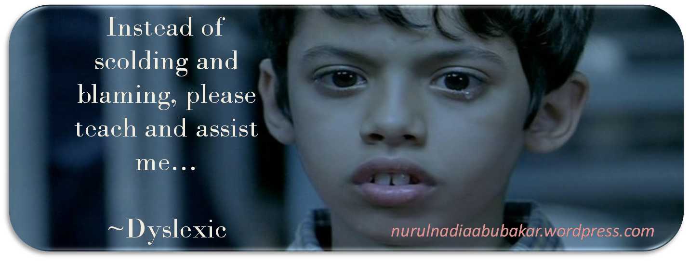
THANK YOU
Lets make their life easier

