Slide 1
How to make Maths Fun for Elementary Kids ??
Mrs. Anshula Saxena
PGT (Maths), CHGS(K), BHU, Varanasi

Slide 2
Why Maths is difficult for most people?
1. Even when you are doing it right, you might still be wrong.
2. Maths build on itself.
3. Understanding the method but not the reason leads to forgetting.
4. Lack of practice.
5. Somebody told you that “Maths is DIFFICULT” and you believe it.
6. You are not a good reader i.e. you are not a critical reader.
7. Many concepts are abstract.
8. You do not like Maths instead you like music, drawing, etc.
9. You do not get some extra help from teacher, parents or friends.
10. You believe that you can just learn a concept and then forget. Actually Maths is cumulative.

Slide 3
Maths can be a HIT or a MISS subject for students....
To help students learn Maths concepts in class, and have the confidence to transfer those skills to real life situations, educators must find ways to better teach the subject.
So now let us take a look at the different ways which can make MATHS FUN for the elementary kids (age group 8 to 12 years).

Slide 4
1. Use modelling and students name
Every concept that’s taught should have meaning and relevancy in the real world and in your students’ lives.
Using a student’s name in a Maths problem (while teaching addition, subtraction, etc.) is an effective way to keep your class engaged.

Slide 5
2. Build character through competition
Teaching Maths through competition is an especially great way to get students excited about learning.
The class competes to see who can solve the problem in one minute.
Reward the child-
  Mathematician of the day
  In the form of candies

Slide 6
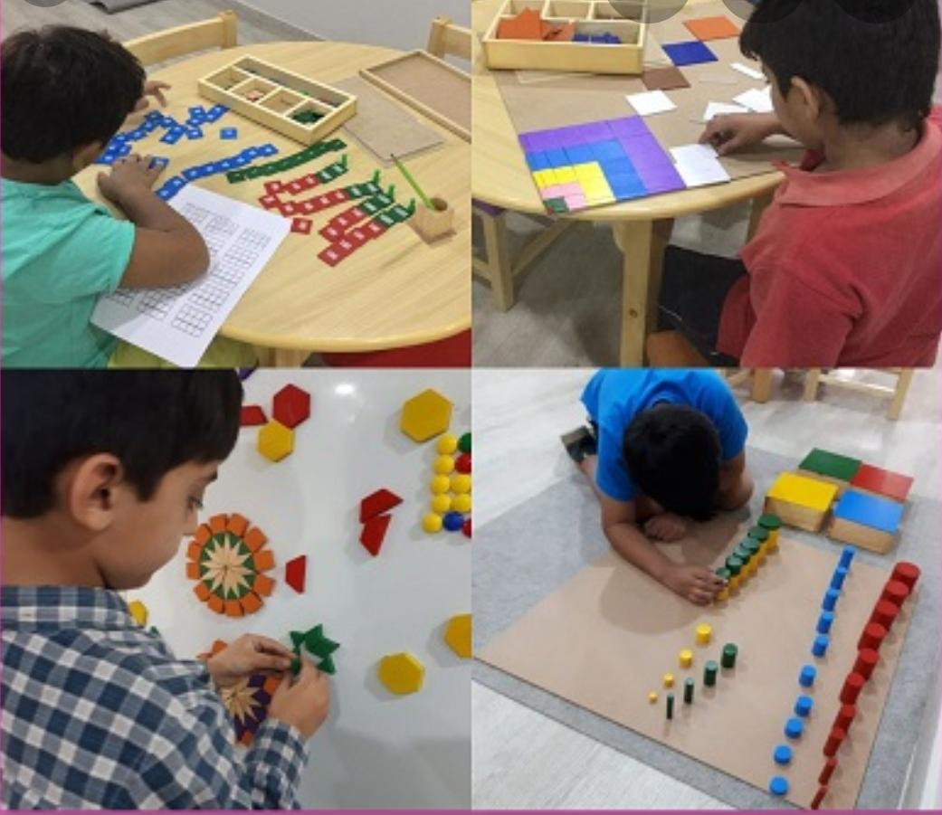

Slide 7
3. Entice learners with games
Games are a fun and engaging way to reinforce concepts taught in the classroom.
Activity-
  Divide the class into groups.
  Give them some materials such as colour paper, scissors, glue, etc.
  Give them problem to solve using the materials given.

Slide 8
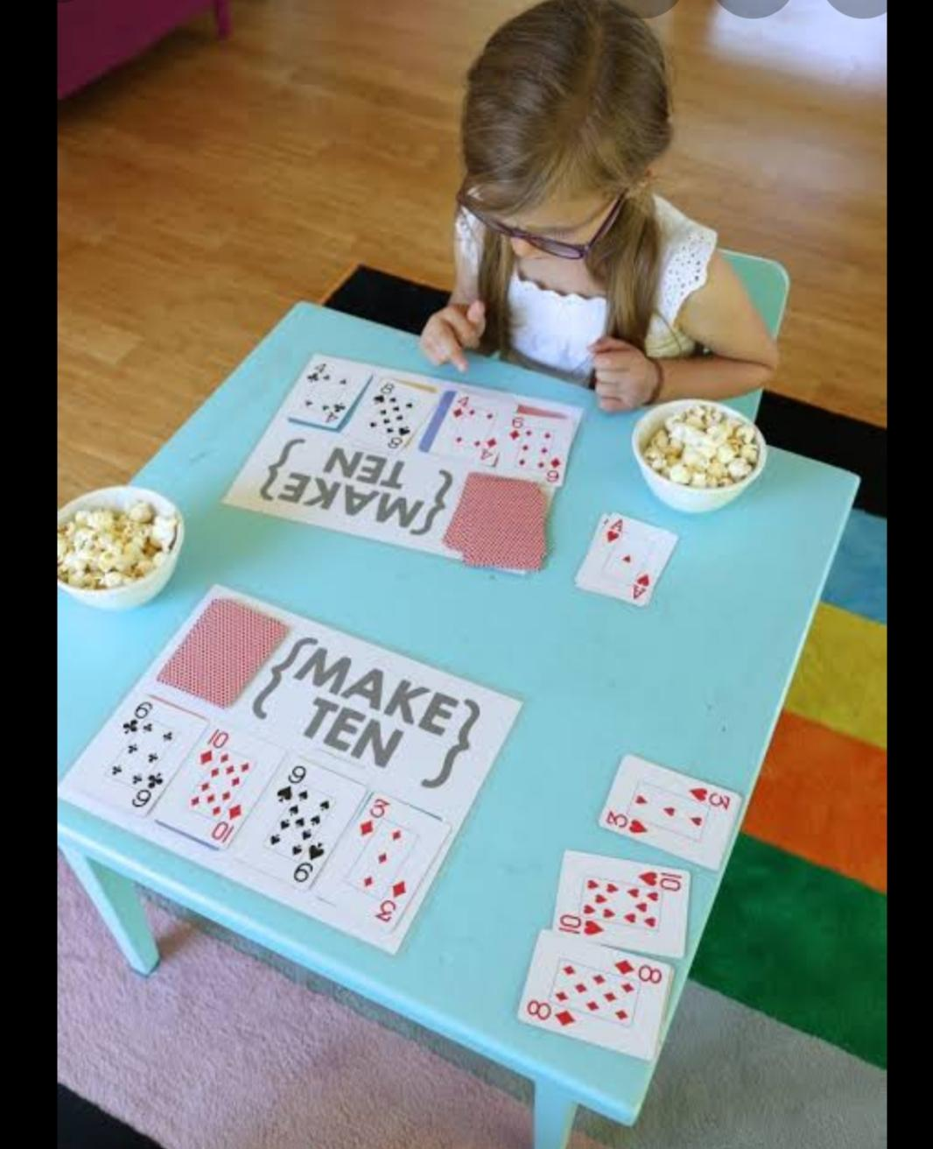

Slide 9
4. Use picture books
In lower grades picture books representing counting, addition, subtraction can be used.
Read –aloud are ideal for drawing children into the Maths skill that will be taught.

Slide 10
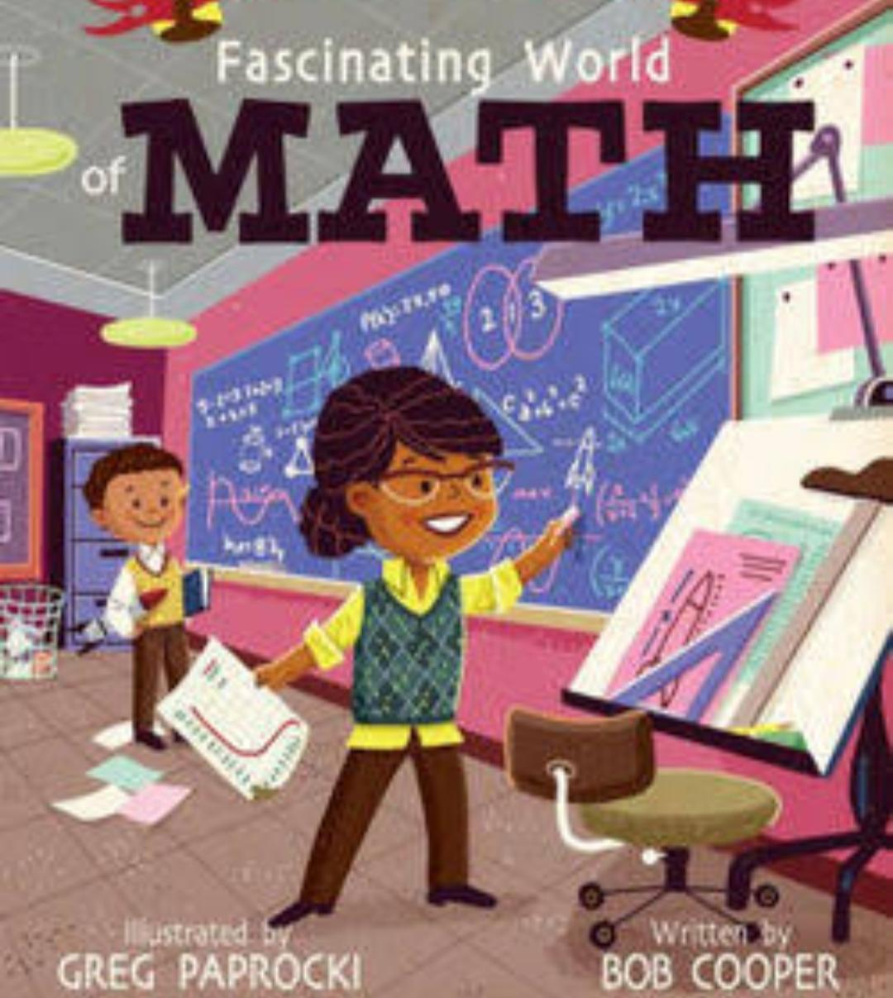

Slide 11
5. Bring in real objects
Make sure students know how Maths apply to everyday life.
Ask the students to investigate around them the areas where they can find the topic currently going on in the classroom.
You can be really creative when teaching topics like geometry, measurement, graphing, addition,.. just about any Maths topic.

Slide 12
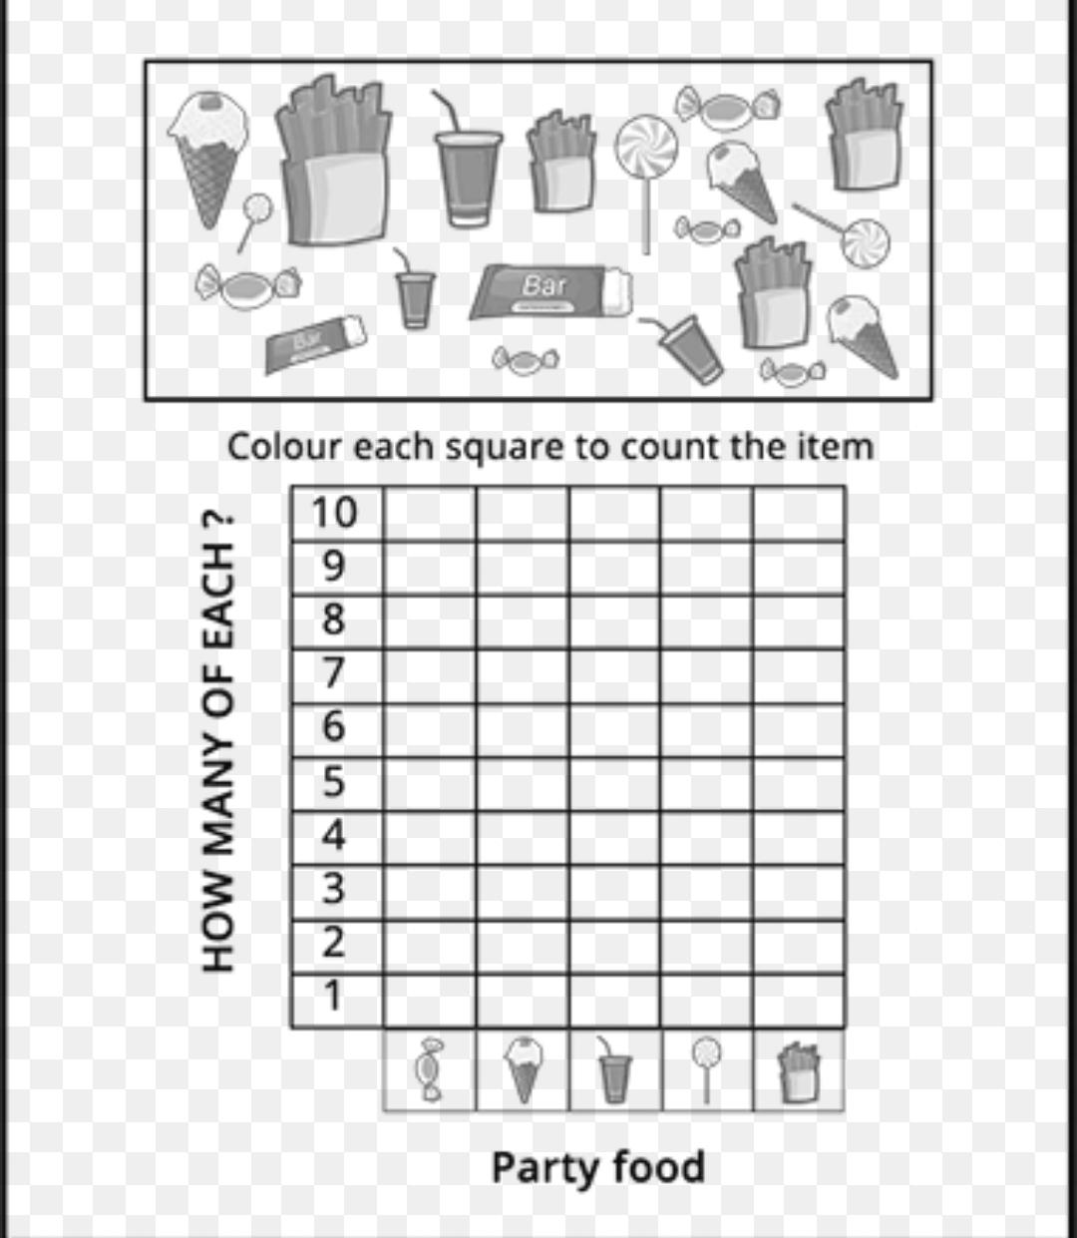

Slide 13
6. Add cheers
Creating an encouraging environment can help melt away the fear that some of our kids have about Maths.
Cheers are a great way to motivate students.
It is even more effective when students give cheers to each other.

Slide 14
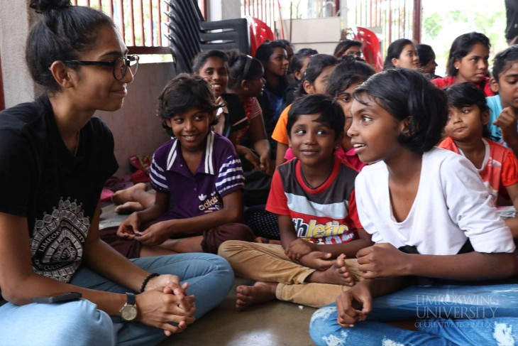

Slide 15
7. Let students make their own problem
Kids get excited about creating problems for their classmates to solve.
Students love to see the problems they create solved by their friends.
Children feel motivated and build their confidence.

Slide 16
8. Provide visuals
Talking about student engagement clear and student friendly visual representations are always a must.
Students get bored looking at the same traditional methods of teaching hence anything different attracts their attention.
Visuals will hold their attention and help better understanding abstract ideas.
Story telling with the help of visuals can be used.

Slide 17
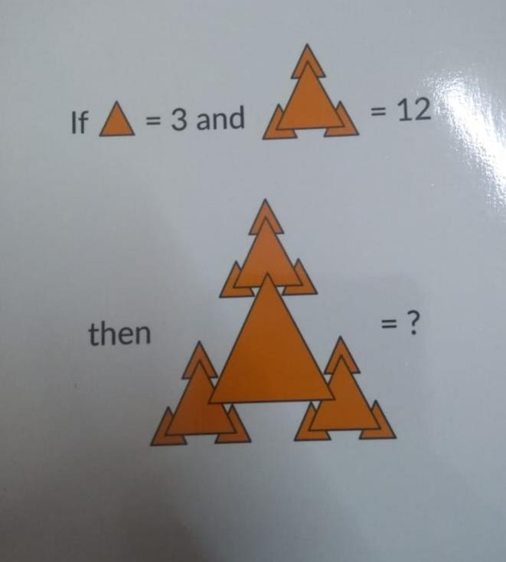

Slide 18
9. Integrate Science and Social Sciences
Integrated projects
Introduce STEM projects--- they focus on real world problems and are usually collaborative.
E.g... If students are studying about goods and services in social sciences, money would be perfect connecting topic.
If students are studying about plants in science, symmetry and measurement would be perfect connecting topic.

Slide 19
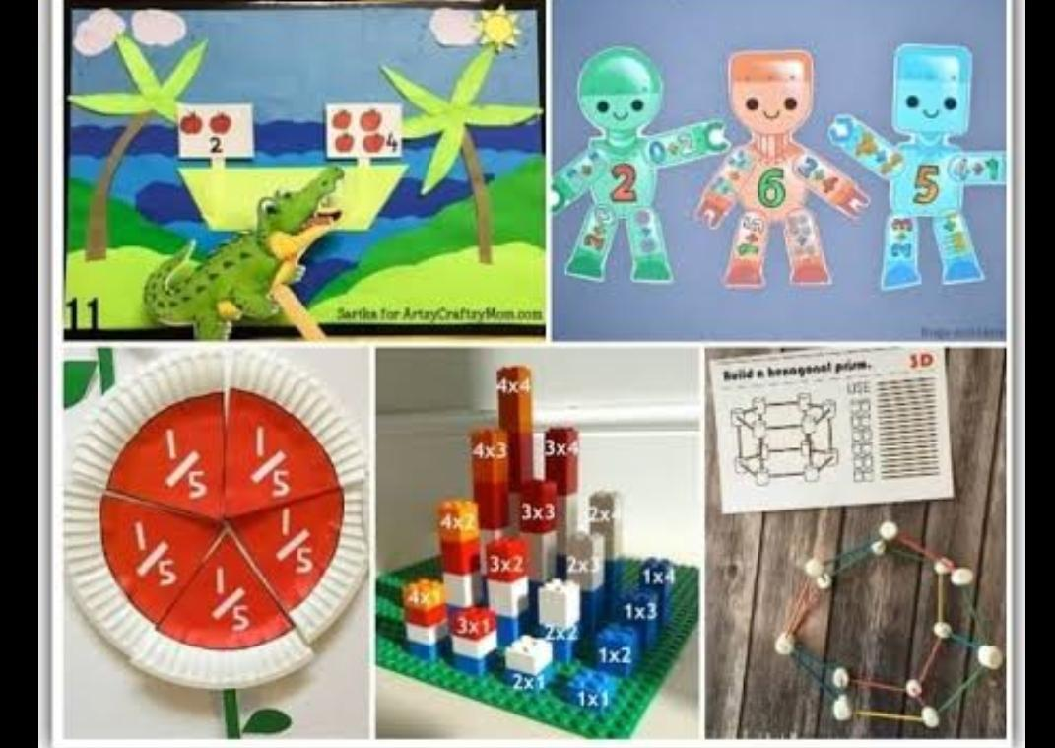

Slide 20
10. Draw Maths models
CPA (Concrete- Pictorial- Abstract) model developed by American psychologist Jerome Bruner can be used.
In this model first manipulate concrete objects, then move onto drawing models through picture representation and finally use only numbers and Maths symbols (which is abstract for them).

Slide 21
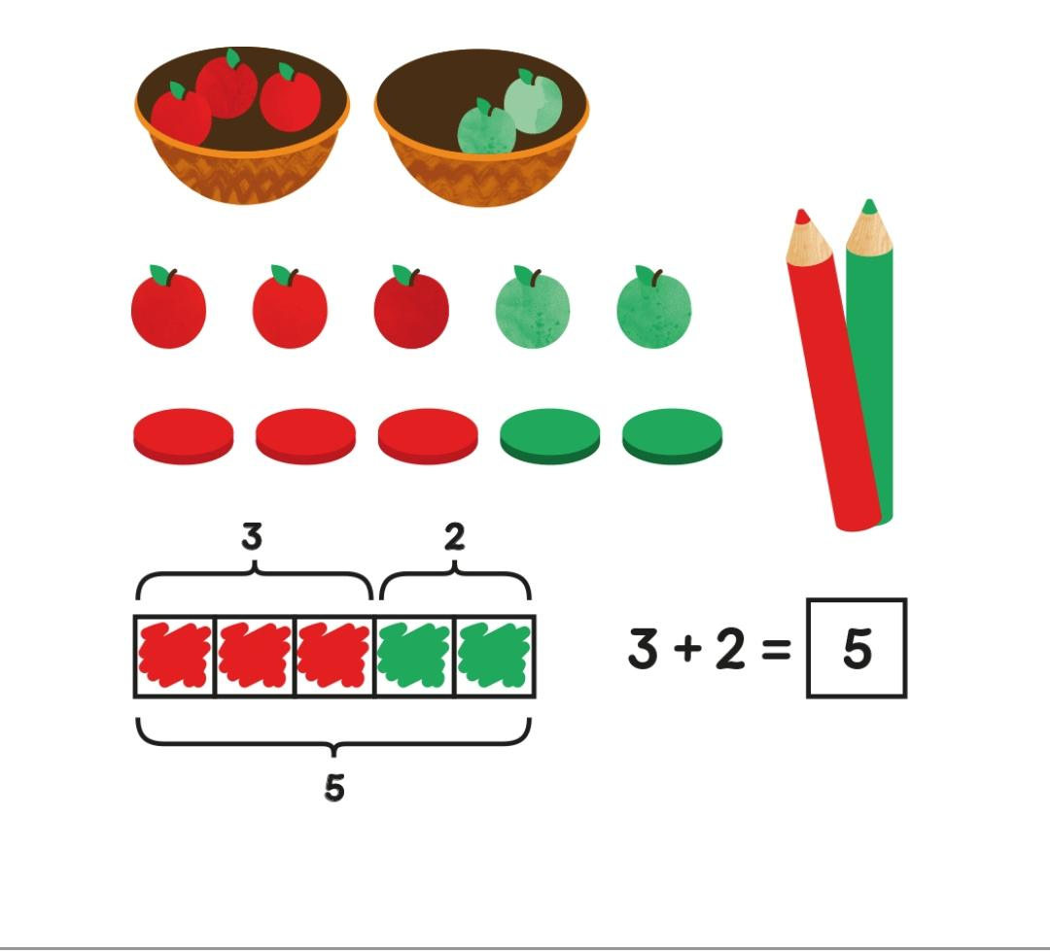

Slide 22
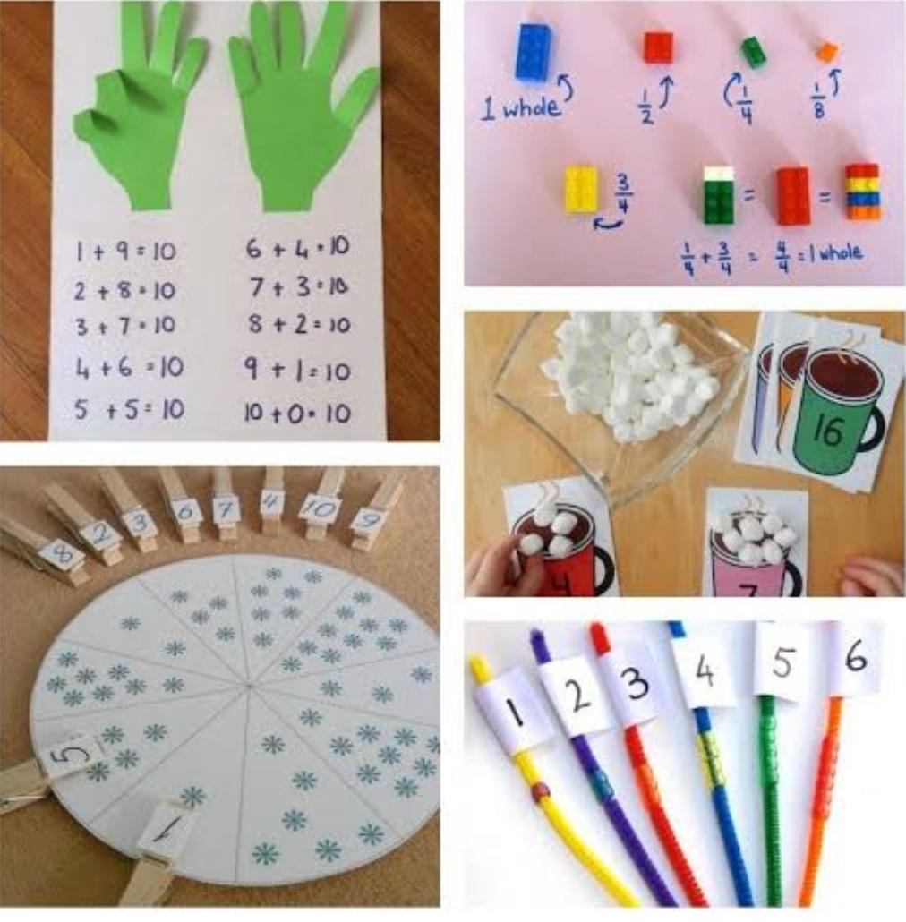

Slide 23
11. Differentiate
You can differentiate a Maths lesson by-
  Content (what is being learned)
  Process (the actual activity)
  Product (how students demonstrated mastery)

Slide 24
12. Make it relatable
Try infusing Maths topic into whatever is going on during that time of the year.
Celebrate special Maths events.
Conduct community surveys.
Create problems involving what they eat, their birthday, their achievements.....
Have students actually act out word problems using real life objects.

Slide 25
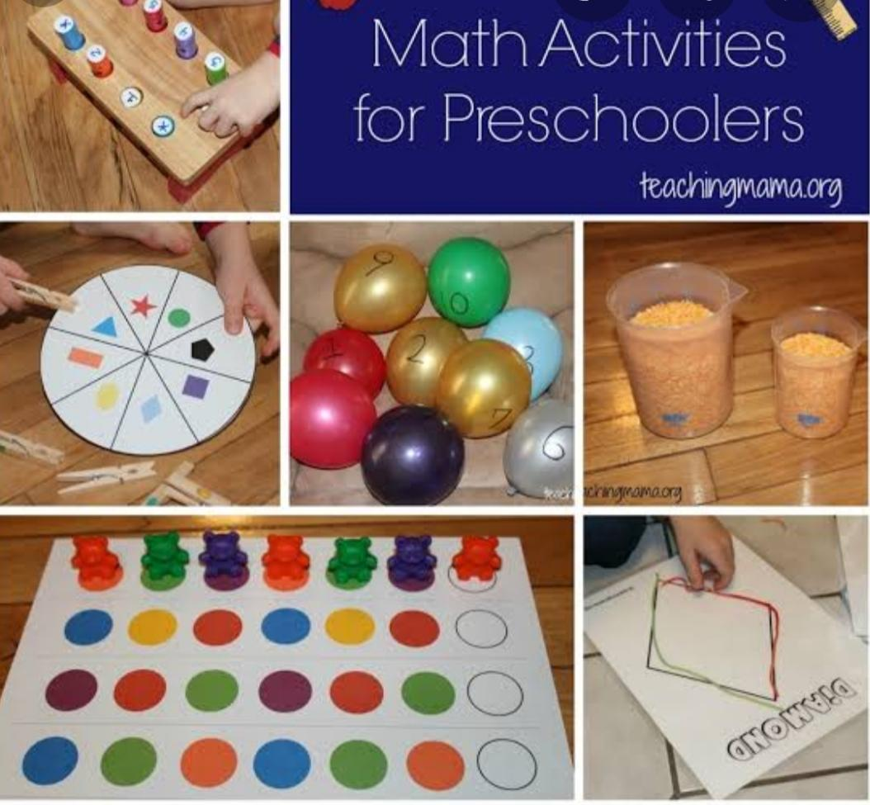

Slide 26
13. Encourage
Maths talk- conduct meaningful conversations about Maths.
Maths quizzes- ask interesting questions.
Brain storming- ask questions where there may be more than one answer. Kids will become motivated to find them all.
Cooperative learning- arrange group learning as many times children learn better from their peer group.

Slide 27
14. Go online
There are so many cool Maths websites and apps that can create interest in them. Some such sites are -
* Maths game time *Kahoot
* Geogebra * MATH Goodies
* MATH TV * Math- Aids
* Khan Academy * AAA Math
* Math is Fun * Math-e-magic

Slide 28
15. For we the TEACHERS
Enthusiasm: We need to show the same amount of enthusiasm that we want to see in students.
Make it hands-on: Try turning a lesson that may normally include a lecture into an interactive one.
Get up and move.
Use frequency modulation.
Know about your kids interest.
Plan the lessons well.

Slide 29
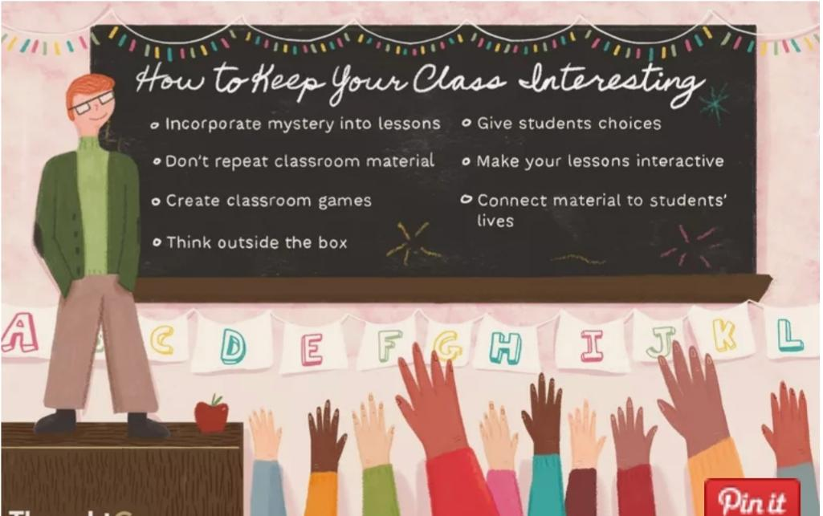

Slide 30
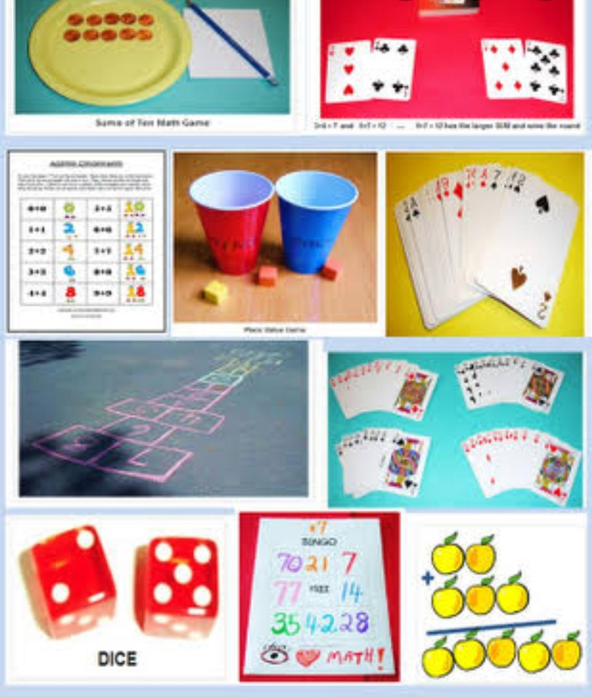
THANK YOU

