Slide 1
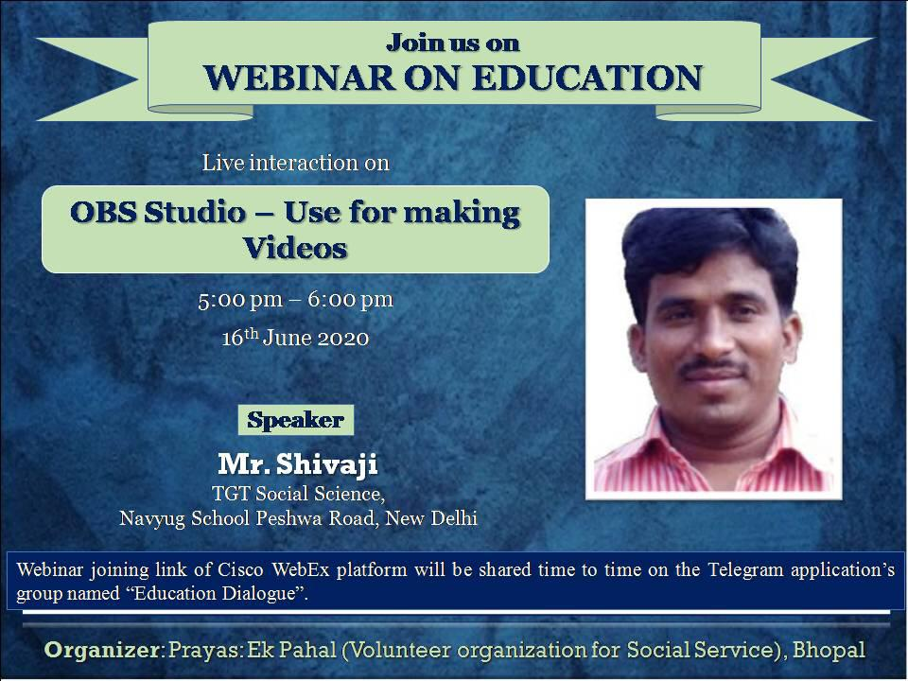

Slide 2


Slide 3
WHAT IS Open Broadcaster Software (OBS)
Open Broadcaster Software (OBS) is a free and open-source software suite cross-platform for recording and live streaming program built with Qt and maintained by the OBS Project. As of 2016, the software is now referred to as OBS Studio.

Slide 4
* (Qt is a free and open-source widget toolkit for creating graphical user interfaces as well as cross-platform applications that run on various software and hardware platforms such as Linux, Windows, macOS, Android or embedded systems with little or no change in the underlying codebase while still being a native application with native capabilities and speed.)

Slide 5
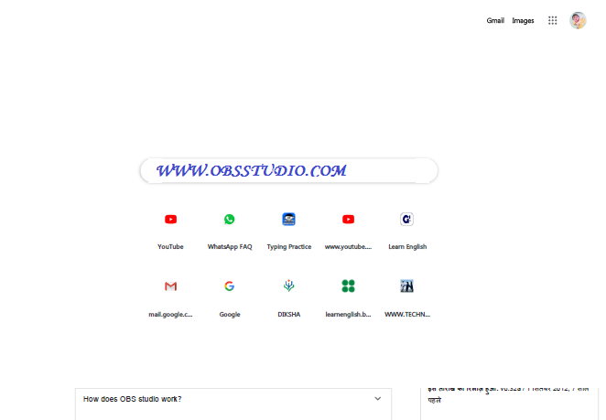
WWW.GOOGLE.COM
SURCH AND DOWNLOAD OBS Studio

Slide 6
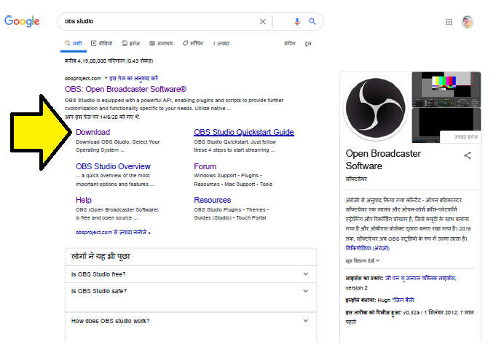
CLICK ON OBS DOWNLOAD

Slide 7
Install & Configure OBS Studio
Open Broadcaster provide an OBS Studio which is free and open source software for video recording and live streaming. This can be downloaded from
WWW.obsstudio.com
Once it has finished downloading double click on the .exe to install the OBS Studio application.

Slide 8
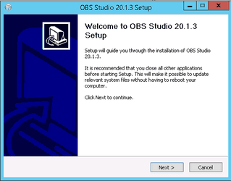
Installing OBS Studio
CLICK ON NEXT BUTTON
CLICK
ON
NEXT
BUTTON

Slide 9
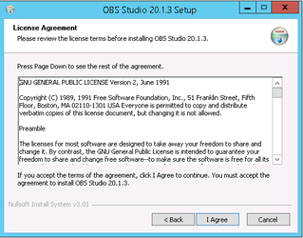
CLICK
ON
I AGREE
BUTTON

Slide 10
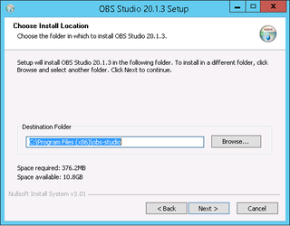
Select your preferred Destination folder and click Next

Slide 11
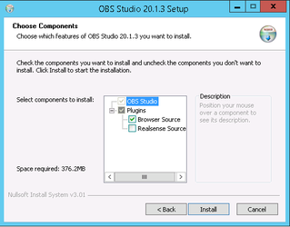
We have chosen to just install the default components but you can choose what you wish and click Install.

Slide 12
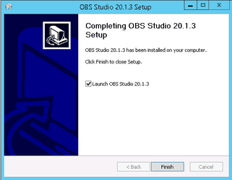
Leave the box ticked to Launch OBS Studio and click Finish.
You will see the Licence Agreement displayed, click OK to continue to launch OBS Studio.

Slide 13
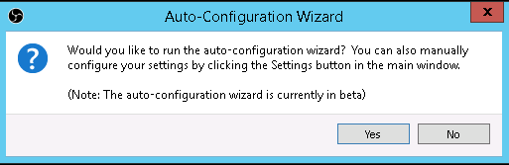
If you wish to use the Auto-Configuration Wizard click Yes, otherwise click No and you will need to configure OBS Studio manually via the Settings button. You can always change settings later if required. We have chosed to click Yes.

Slide 14
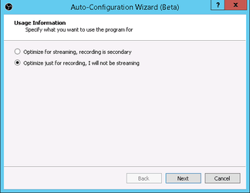
As we want to create a video recording we have chosed to Optimize just for recording but it is up to you. Choose the option best for you and click Next.

Slide 15
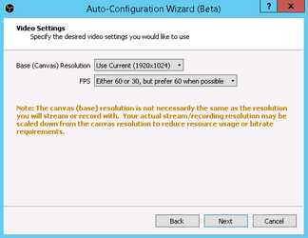
We have left the default options and clicked Next.

Slide 16
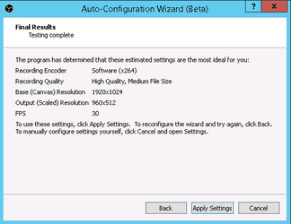
This displays the results of testing with the selected options. Either click Apply Settings or click Back if you want to make changes.

Slide 17
This displays the results of testing with the selected options. Either click Apply Settings or click Back if you want to make changes.

Slide 18
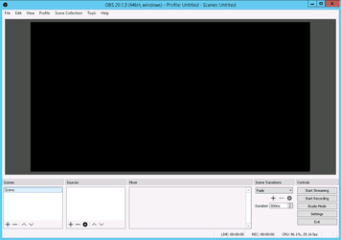
OBS Studio launches.

Slide 19
Configuring OBS Studio
You now need to configure OBS Studio to point to a folder where you wish your videos to be created and the format of the video (mp4).
Select Settings from the File menu.
Click on the Output button.

Slide 20
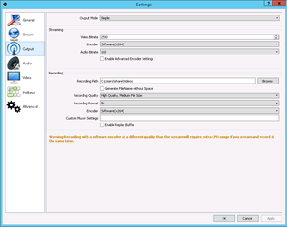
There are other Settings you may wish to explore.

Slide 21
DEMOSTRATION IN OBS SOFTWARE
FOR THIS DEMONSTRATION VIDIO CLICK ON
WWW.TEACHNSPR.WORDPRESS.COM
OR
WHATS APP ME ON 8076831744.

Slide 22
Is OBS really free?
Absolutely! OBS is open-source software developed by volunteer contributors around the world in their free time. OBS is distributed under the GPLv2 license. The summary of the license is that OBS is free for anyone to use, for any reason. Other developers can use the OBS code in their own projects as long as they obey the guidelines set forth in the GPLv2 license. OBS has no watermarks or other limitations and can be used commercially with no restrictions.

Slide 23
IS IT USER INTERFACE?
The main user interface is organized into five sections: scenes, sources, audio mixer, transitions, and controls. Scenes are groups of sources like live and recorded video, text and audio. The mixer panel lets the user mute the audio, and adjust the volume through virtual faders, and apply effects by pressing the cogwheel next to the mute button.

Slide 24
The control panel has options for starting/stopping a stream or recording, a button to transform OBS to a more professional Studio Mode (see below), a button for opening the settings menu and a button to exit the program. The upper section has a live video preview, used to monitor and edit the current scene. The user interface can be switched to a variety of themes, including both dark and light themes, depending on what the user prefers.

Slide 25
Is OBS safe to use? Is it virus free?
Yes! OBS is an open source project, which means the programming code is open for anyone to look at or improve, so you can see exactly how it works. Any changes to the code are reviewed by other OBS contributors, so no one can add anything malicious. As long as you download OBS from this website, you will receive the latest version which is safe to use and free of malware. OBS contains no advertisements or bundled software / adware - if you've been asked to pay for OBS, this is a scam and you should request a refund or charge back the payment.

Slide 26
As long as you download OBS from this website, you will receive the latest version which is safe to use and free of malware. OBS contains no advertisements or bundled software / adware - if you've been asked to pay for OBS, this is a scam and you should request a refund or charge back the payment

Slide 27
The quality on my stream or recording is bad! How can I fix it?
The quickest way to make sure you have good settings is to use the Tools / Auto Configuration Wizard in OBS. This will get most basic settings correct for you. If you are streaming, check out our Streaming with x264 guide for a primer on video encoding and how to adjust settings further to get the most out of your stream.

Slide 28
* If you are recording, try using Simple output mode and the recording presets. If you have an available hardware encoder, try to use that for your recordings. For more in-depth options, see our local recording guide.

Slide 29
IS IT UPDATEING TIME TO TIME?
We are very careful about making updates, and test everything as extensively as we can. Most commonly, updates will cause antivirus and security programs to look closer at OBS. Some can even flag the behavior, falsely, as malicious.

Slide 30


