Slide 1
The Impact of National Education Policy-2019 on Language
ANIMESH DAS
Student, Integrated B.Ed.-M.Ed.
Regional Institute of Education (NCERT) Bhopal

Slide 2
Language in the Colonial Era
Language after Independence
NPE 68, 86, POA 1992
NCF 2005 and Language
NEP 2019 and Language

Slide 3

What is Language?
“Language is nothing but a set of human habits, the purpose of which is to give expression to thoughts and feelings, especially to import them to others”
Otto Jesperson
Language, a system of conventional spoken, manual (signed), or written symbols by means of which human beings, as members of a social group and participants in its culture, express themselves. The functions of language include communication, the expression of identity, play, imaginative expression, and emotional release.
Encyclopedia Britannica

Slide 4
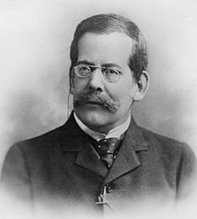
“Language is the expression of ideas by means of speech-sounds combined into words. Words are combined into sentences, this combination answering to that of ideas into thoughts.”
(Henry Sweet)
“A language is a system of arbitrary vocal symbols by means of which a social group cooperates.”
American linguists Bernard Bloch and George L. Trager

Slide 5
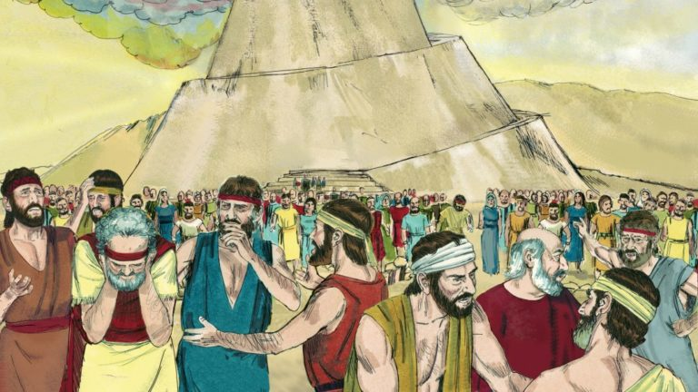
Importance of Language: Story of The Tower of Babel
According to the Bible, men had grown very proud to the point of believing, they were as mighty as God.So they decided to build a great tower that would reach the sky,.
But God is mightier than they, caused their tongues to no longer spoke the same language.Men could not understand one another‟s directions or orders.The tower could not be completed because of the lack of means of understanding.Thus the story tells us the importance of language for expression and understanding.

Slide 6
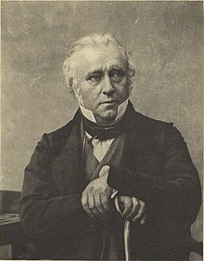
Pre-Colonial Era
Sanskrit + Persian (Link Language)
Language Education Policy in the Colonial Period
Thomas Babbington Macaulay “Minutes of Education”
‘We must at present do our best to form a class who may be interpreters between us and the millions who we govern; a class of persons, Indian in blood and colour, but English in taste, in opinion, in morals and in intellect.’(Sharp et al.,1920,p.102)

Slide 7
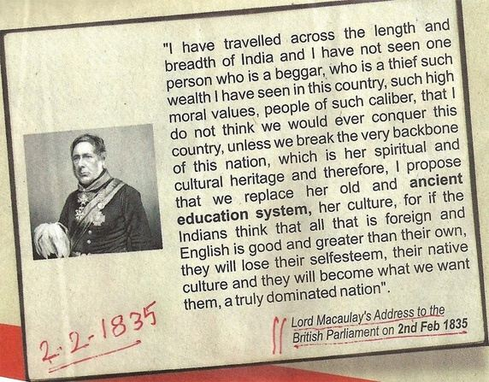
‘Macaulay’s Minute very clearly argues for English as the medium of instruction at higher levels, rather than the oriental languages. The Minute constitutes an example of colonialist and imperialist attitude of superiority’(Pingali,2009,p.106).

Slide 8
Language Education Policy After Independance
Indian Constitution Assembly established on 9th Dec 1946.
Debates on ---The adoption of a "National Language", the language in which the constitution was to be written in and the language in which the proceedings of the assembly were to be conducted .
On 10 December 1946, Raghunath Dhulekar declared "People who do not know Hindustani have no right to stay in India. People who are present in the House to fashion a constitution for India and do not know Hindustani are not worthy to be members of this assembly. They had better leave.“
The adoption of Hindi as the national language was opposed by members from South India like T.T.Krishnamachchari G. Durgabai, T.A.Ramalingam Chettiyar N.G.Ranga. Gopalaswamy Ayyangar (all belonging to Madras) and S. V. Krishnamurthy Rao (Mysore). This anti-Hindi block favoured retaining English as official language.

Slide 9

Munshi- Ayyangar Formula
Part 17th (343-351) of the Indian Constitution was drafted according to this compromise. It did not have any mention of a "National Language". Instead, it defined only the "Official Languages" of the Union.
Hindi in Devanagari script would be the official language of the Indian Union. For fifteen years, English would also be used for all official purposes (Article 343).
A language commission could be convened after five years to recommend ways to promote Hindi as the sole official language and to phase out the use of English (Article 344).
Official communication between states and between states and the Union would be in the official language of the union (Article 345).

Slide 10
Constitutional Provisions
English would be used for all legal purposes -in court proceedings, bills, laws, rules and other regulations (Article 348).
Article 350- Language to be used in representations for redress of grievances.
Article 350A- Facilities for instruction in mother-tongue at primary stage.
Article 350B- Special Officer for linguistic minorities.
Article 351- Directive for development of the Hindi language

Slide 11
National Policy on Education 1968
Provisions for the promotion and development of Languages
Focus on Regional Languages and Literature
At the State Level: The Three Language Formula
Focus on the Promotion and Development of Hindi
Study of Sanskrit specifically in courses such as Modern Indian Languages, Ancient Indian History, Indology and Indian Philosophy
Special Emphasis on the study of English and Other International Languages.

Slide 12
National Curriculum Framework 2005
An across the curriculum approach that Breaks down the barrier between English and other subjects and English and other languages.
The child learns language not merely as a subject but as a medium.
• A renewed effort should be made to implement the three-language formula, emphasizing the recognition of children's home language(s) or mother tongue(s) as the best medium of instruction. These include tribal languages.
• Multilingual approach in teaching languages.

Slide 13
National Curriculum Framework 2005
Revival of the Sanskrit and Urdu Language
Incorporating Language With Art and drama
Focus on the use and teaching of Braille and Sign Languages.

Slide 14
National Education Policy 2019
Teaching in home languages/mother tongue at School for the better understanding of the learners.
Need to develop textbooks and learning materials in local and tribal languages.
Focus on Bilingual approach (especially in Science teaching) and the use of Bilingual Teaching learning resources.
All students from pre-school and grade-1 should be exposed to learn atleast three languages.
Standardization of the Indian Sign Languages. National and State Curriculum Materials should be developed.
Multilingualism for expanding the horizon of knowledge.
Shift of focus from English to the other Indian Languages.
With Indian Languages the world languages should also be taught.

Slide 15
National Education Policy 2019
Decentralization of English (Foucault) and giving equal importance to the languages in the margins of the National discourse.
Most Advanced Countries (China, Japan) use their own languages.
Bilingual approach in the areas of science and technology.
Recruitment of teachers for teaching local languages.
Flexibility In the three language formula- Option of changing the languages.
Foreign language teaching in secondary schools ( French, German, Spanish, Chinese and Japanese)

Slide 16
National Education Policy 2019
Home and local languages and second languages will be enriched with the reading and analysis of uplifting literature.
Other art forms like Theater, film excerpts for the enrichment of local language.
Standardization of Sign Languages.
While teaching the State Languages, other forms of the language and other predominant language of that area should be given importance for inclusivity, interest, enjoyment and enrichment.
(E.g- While teaching Hindi, learn about Khariboli, Awadhi, Maithili, Braj and Urdu)
Focus on classical languages (Tamil, Telugu, Malayalam, Odia, Kannada) and their literature.

Slide 17
Conclusion

Slide 18
References:
Sharp, H. (1920). Bureau of Education, India. Selection from Educational Records, Part I: 1781-1839. Superintendent, Government Printing.
Pingali, S. (2009). Indian English (Dialects of English). Edinburgh University Press.
National Council of Educational Research and Training. (2005). National Curriculum Framework 2005. New Delhi: NCERT.
Kalia,P.(2017).English Language Teaching in India: Trends and Challenges. International Journal of Engineering Applied Sciences and Technology, 2017 Vol. 2, Issue 3, Pages 33-37.Retrieved from https://www.ijeast.com
Government of India.(1968). A Report of National Policy on Education. Retrieved from http://mhrd.gov.in/sites/upload_files/mhrd/files/document-reports/NPE-1968.pdf
MHRD.(2018).Draft National Education Policy 2019. Retrieved from https://innovate.mygov.in/wp-content/uploads/2019/06/mygov15596510111.pdf
Government of India.(1986). A Report of National Policy on Education. Retrieved from http://www.academics-india.com/npe86-mod92.pdf
National Council of Educational Research and Training. (2012). A Synthesis Report on Teaching of English at Primary Level in Government Schools. Retrieved from https://www.ncert.nic.in/departments/nie/del/publication/pdf/English_Primary_level.pdf

Slide 19
Thank You

