Slide 1

Anwesha Mahankudo
Integrated B.Ed- M.Ed (4th sem)

Slide 2
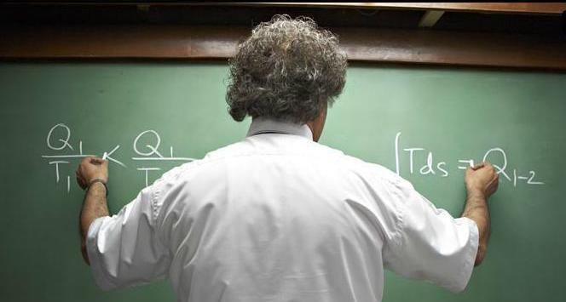


Slide 3
GENDER?
Gender is the sociocultural definition of girls and boys, men and women given by society.

Slide 4




Slide 5
So, what did we observed from the previous image?
The overwhelming association of men with science is called gender-science stereotype.
Similar stereotypes exist for engineering and mathematics also. So, all together it is termed as “ Gender STEM Stereotype”.

Slide 6
ASPECTS OF GENDER STEREOTYPE-
There are two aspects.
1. Explicit – The result of conscious, intentional, and controllable thoughts and beliefs.
2. Implicit- The unconscious attribution of particular thought.

Slide 7
There are some hypothesis of gender STEM stereotypes.
Gender similarities hypothesis.
1. Biological and physical difference
2. Psychological differentiation of gender.
a)Cognitive
b)Social/personal
c) Emotional/well-being

Slide 8
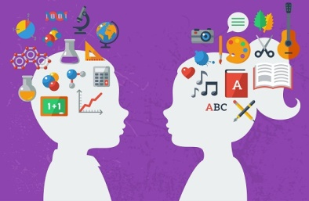
Cognitive :-
Mathematical ability ( Computational, spatial,
reasoning and problem solving)
Verbal ability
Social/Personality :-
Aggressive behavior (physical and verbal)
Helping behavior
Emotional/well being:-
Mood disorders
High/low self esteem

Slide 9
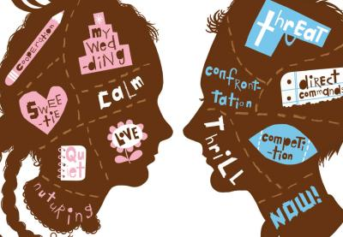

Slide 10
Meta analysis –
Meta analysis summarizes multiple studies with a single average difference “ d ”.
If ‘d’ lies in between 0 & 0.1, it’s interpreted as no difference between male and female.
If the value of ‘d’ is 0.2, it’s interpreted as a small difference.
If the value of ‘d’ ≥ 0.5,it’s a genuine difference.
Dozens of meta analysis have concluded that gender difference is either direction , on most variables are either zero or small.
‘d’ values of 0.5 or more is very rare.
This concluded that the gender similarity hypothesis.

Slide 11
II. Gender difference hypothesis
In 2015, psychologist Ethan Zell and others conducted a meta analysis to find out the gender differences.
They combined both male > female and female> male as just ‘differences’ & concluded that almost 80% overlap and alike.
The remaining 20% of differences are believed as the Gender differences hypothesis.

Slide 12
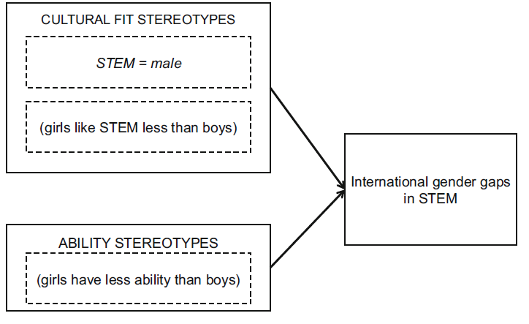
III. Average Ability Hypothesis
Females have lower average ability than males in the cognitive capacities to do well in STEM subjects.
Social and cultural reinforcement differentiates the professions.

Slide 13
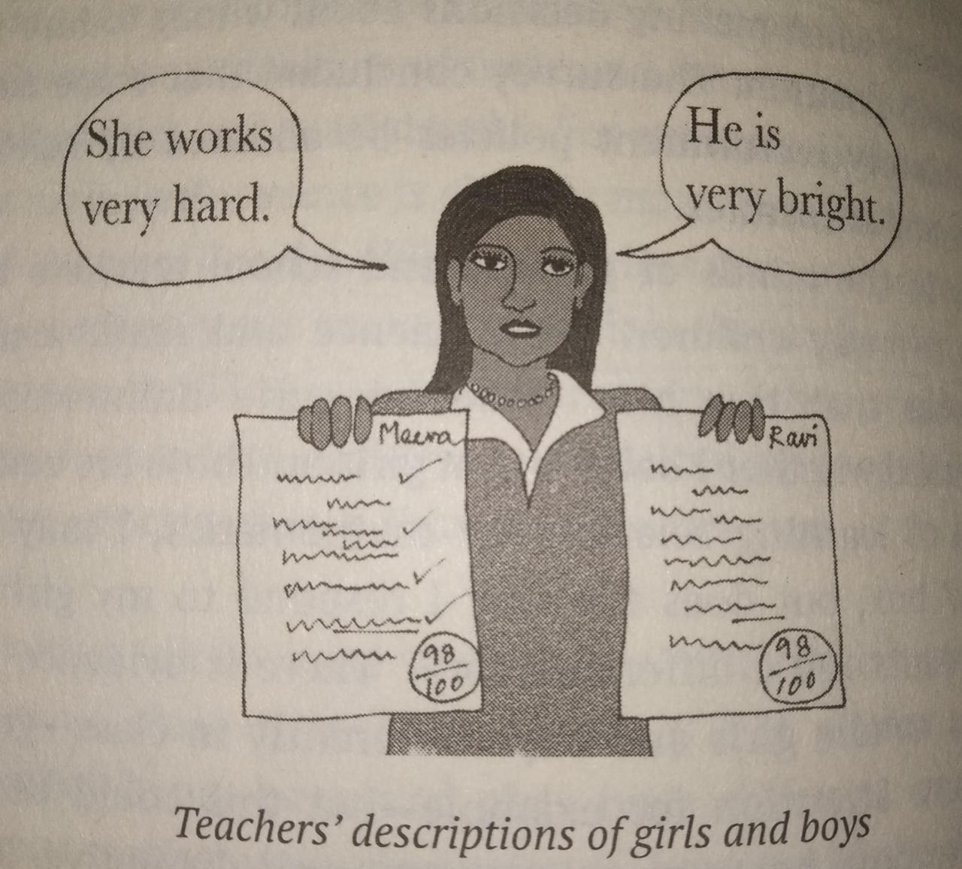
IV. The bias and stereotype hypothesis
Implicit stereotypes works better
Bias in the minds of parents and school teachers
Gender imbalance in STEM fields.

Slide 14
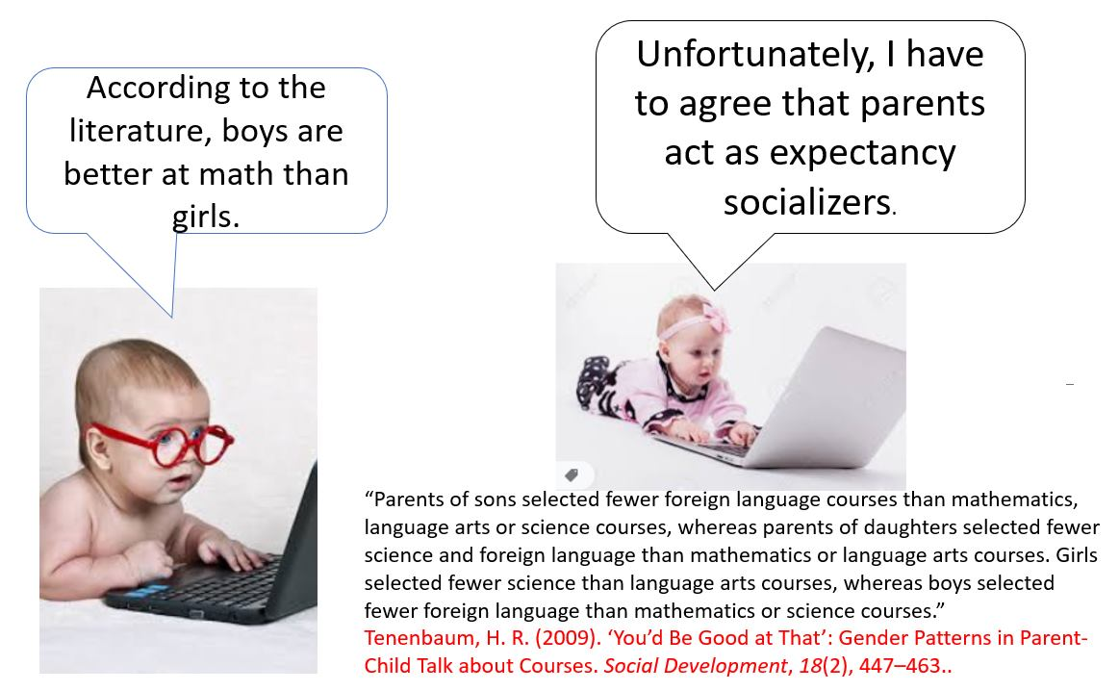

Slide 15

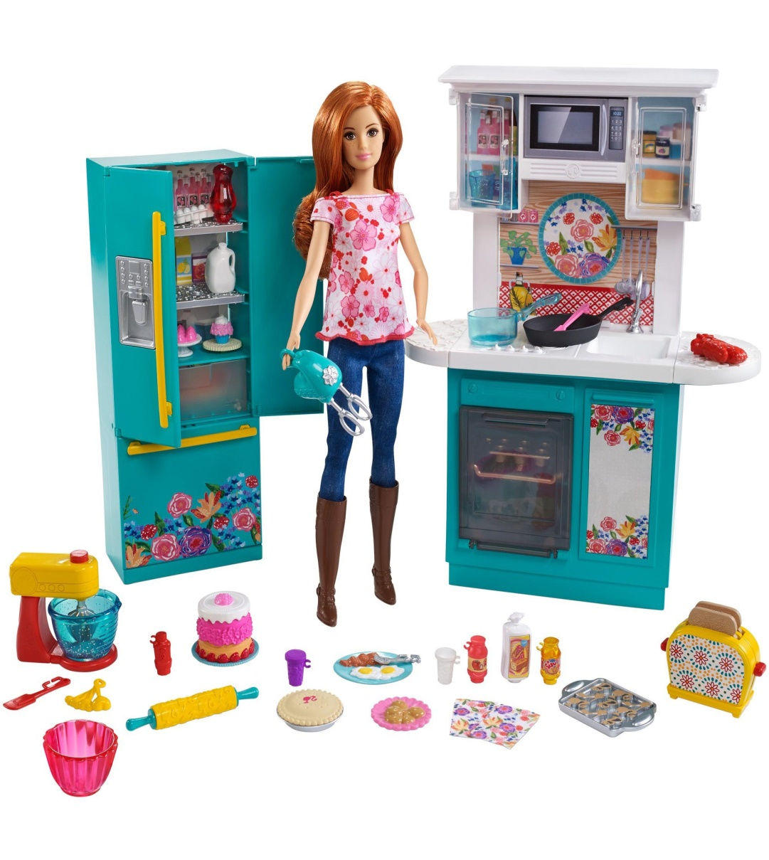
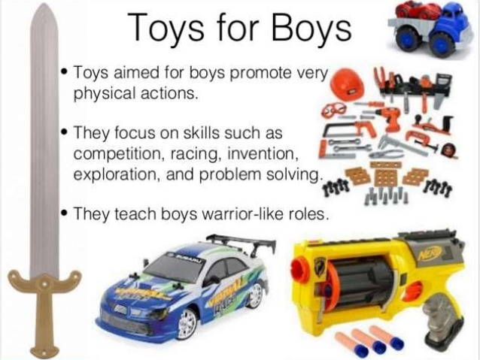

Slide 16
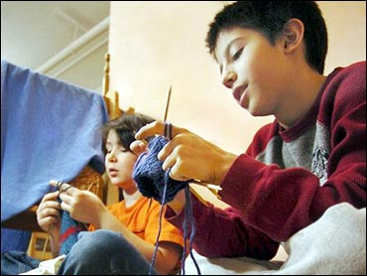
V. The interest hypothesis
Gender appropriate accessories
Innate gender differences
The people versus things
No clear evidences

Slide 17


Slide 18
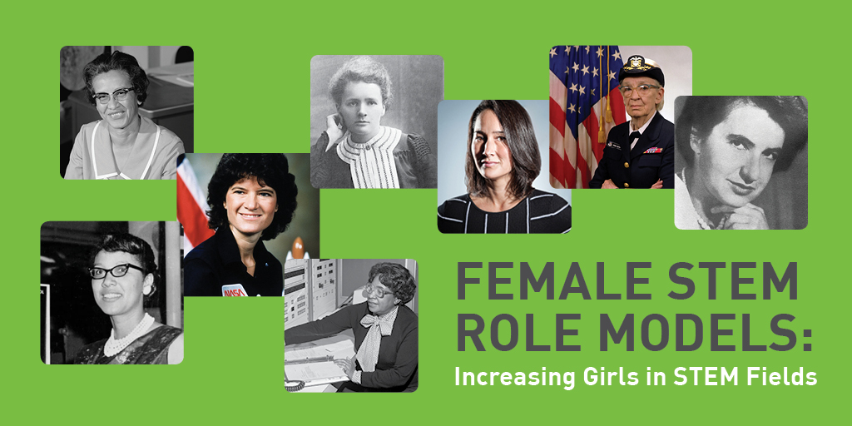

Slide 19
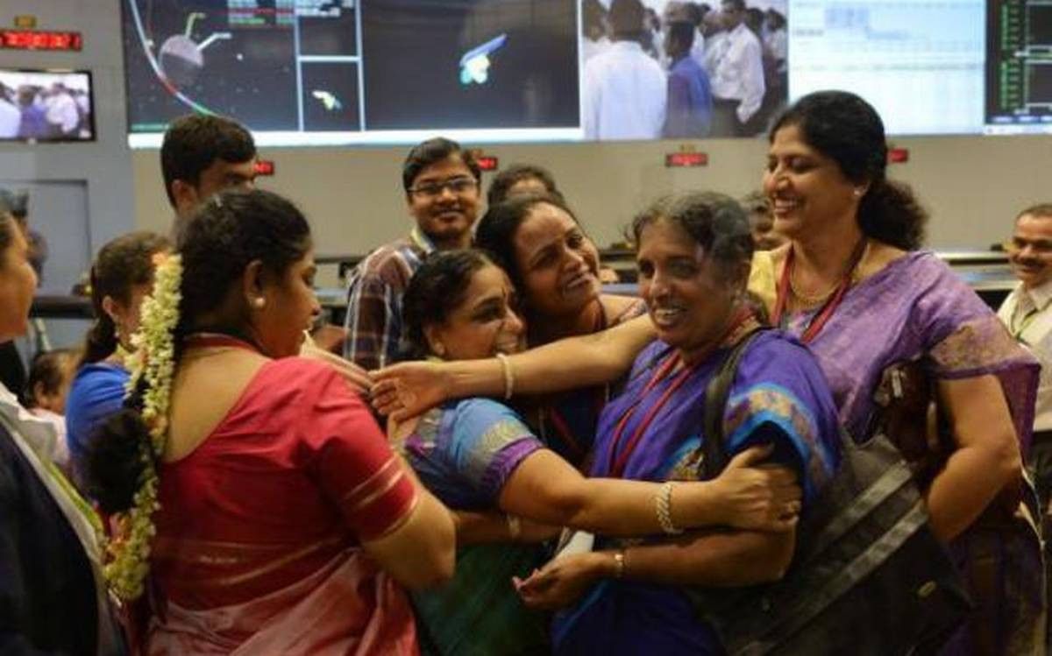

Slide 20




Slide 21


Slide 22
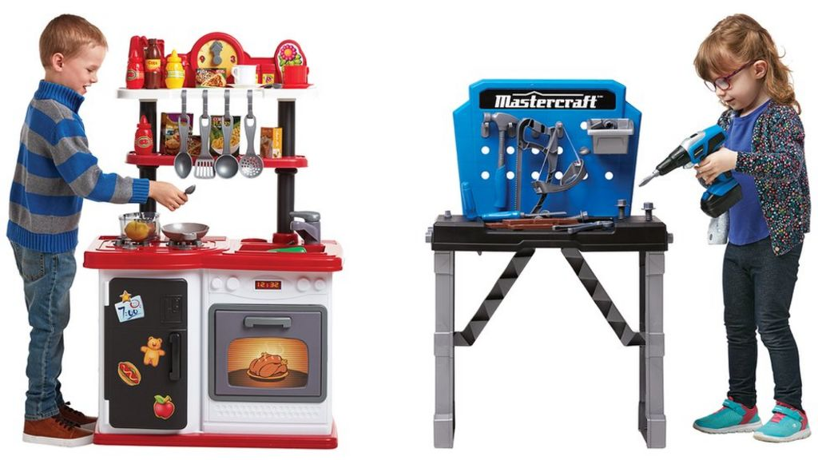


Slide 23

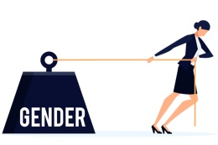

Slide 24
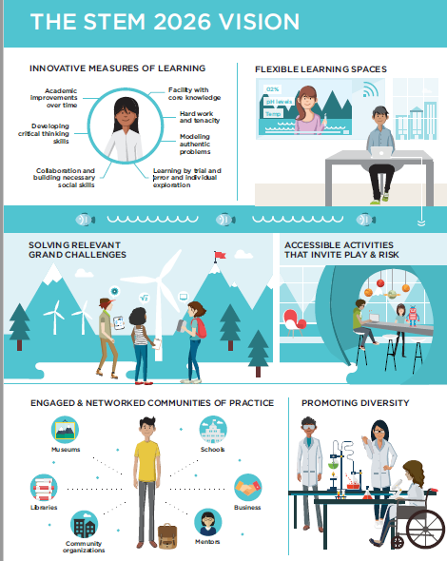

Slide 25
Initiatives by Government of India for promoting women in Science:-
DST(2004)
KIRAN(WOS-A, WOS-B, WOS-C)
CURIE
WOMEN TECHNOLOGY PARKS
VIGYAN JYOTI

Slide 26
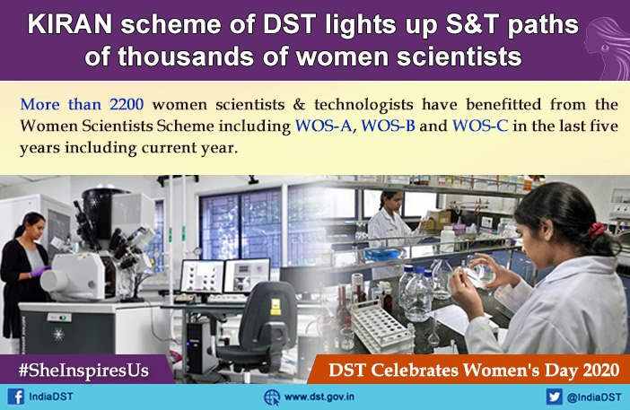

Slide 27
WE NEED NOT TO SEE THE SCHOOL AS AN INSTITUTION WORKING IN HARMONY WITH THE COMMUNITY OR THE LARGEST SOCIETY IN THE MATTER OF GENDER ROLE SOCIALISATION.
- Dr. K. Kumar
So, quite the opposite; teacher must be given the courage to practice just the reverse of what their communities endorse in these matters.

Slide 28
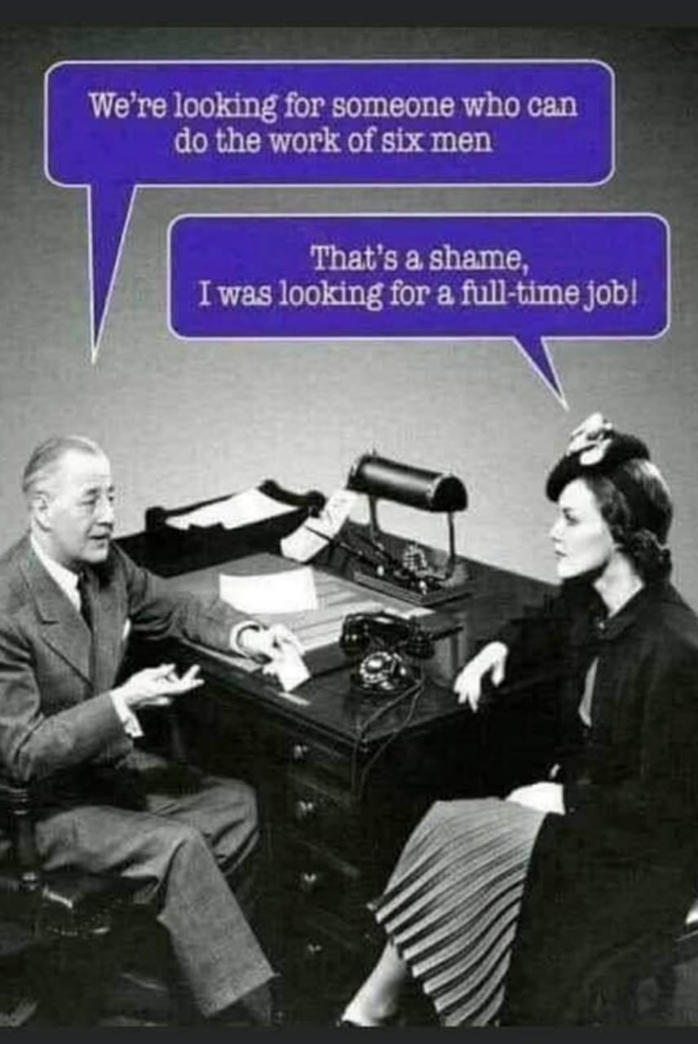

Slide 29
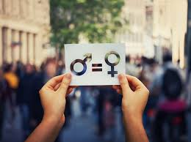
Women should be judged by their ability to do the job and not by their gender.

Slide 30


